Slide 1













Who am I?
Krunal is a Microsoft Azure MVP, and an experienced speaker, author, trainer, and .Net developer with
React – Redux
Angular
Python
Artificial Intelligence + ML
Microsoft Azure
Krunal is serving IT industry as a Corporate Trainer and consultant for 13 years.
Krunal has delivered sessions for reputed clients likes Microsoft,Accenture,JPMC,E&Y,Standard Chartered Bank, Deloitte, Pwc, BNP, Nuance, HCL and many more…
Krunal represents Microsoft to their customers as an Azure Evangelist as well as speaker for numerous conferences such as North America MCT Summit, Microsoft Ignite, Microsoft Ignite The Tour etc.
@TrainerKrunal https://www.linkedin.com/in/trainerkrunaltrivedi/
it.ktrivedi@gmail.com
Notes:
I wanted to take a quick minute to introduce myself. ….

Slide 2
Advanced React with Redux, Router and Forms

Slide 3
React + Redux Agenda
React Component Approach
Stateful Components
Functional Components
Pure Components
Higher Order Components
React Component Lifecycle
React Props – State
React Bindings
React Inter-component communication
React Routing
React Hooks
Making Ajax calls using Axios
Redux
Maintaining State using Redux
Redux Actions
Reducers
Store

Slide 4
What is React?
A JavaScript library for building user interfaces.
React uses component approach to build user interfaces.
We can also easily reuse components. React components can be thought of as custom HTML elements.

Slide 5
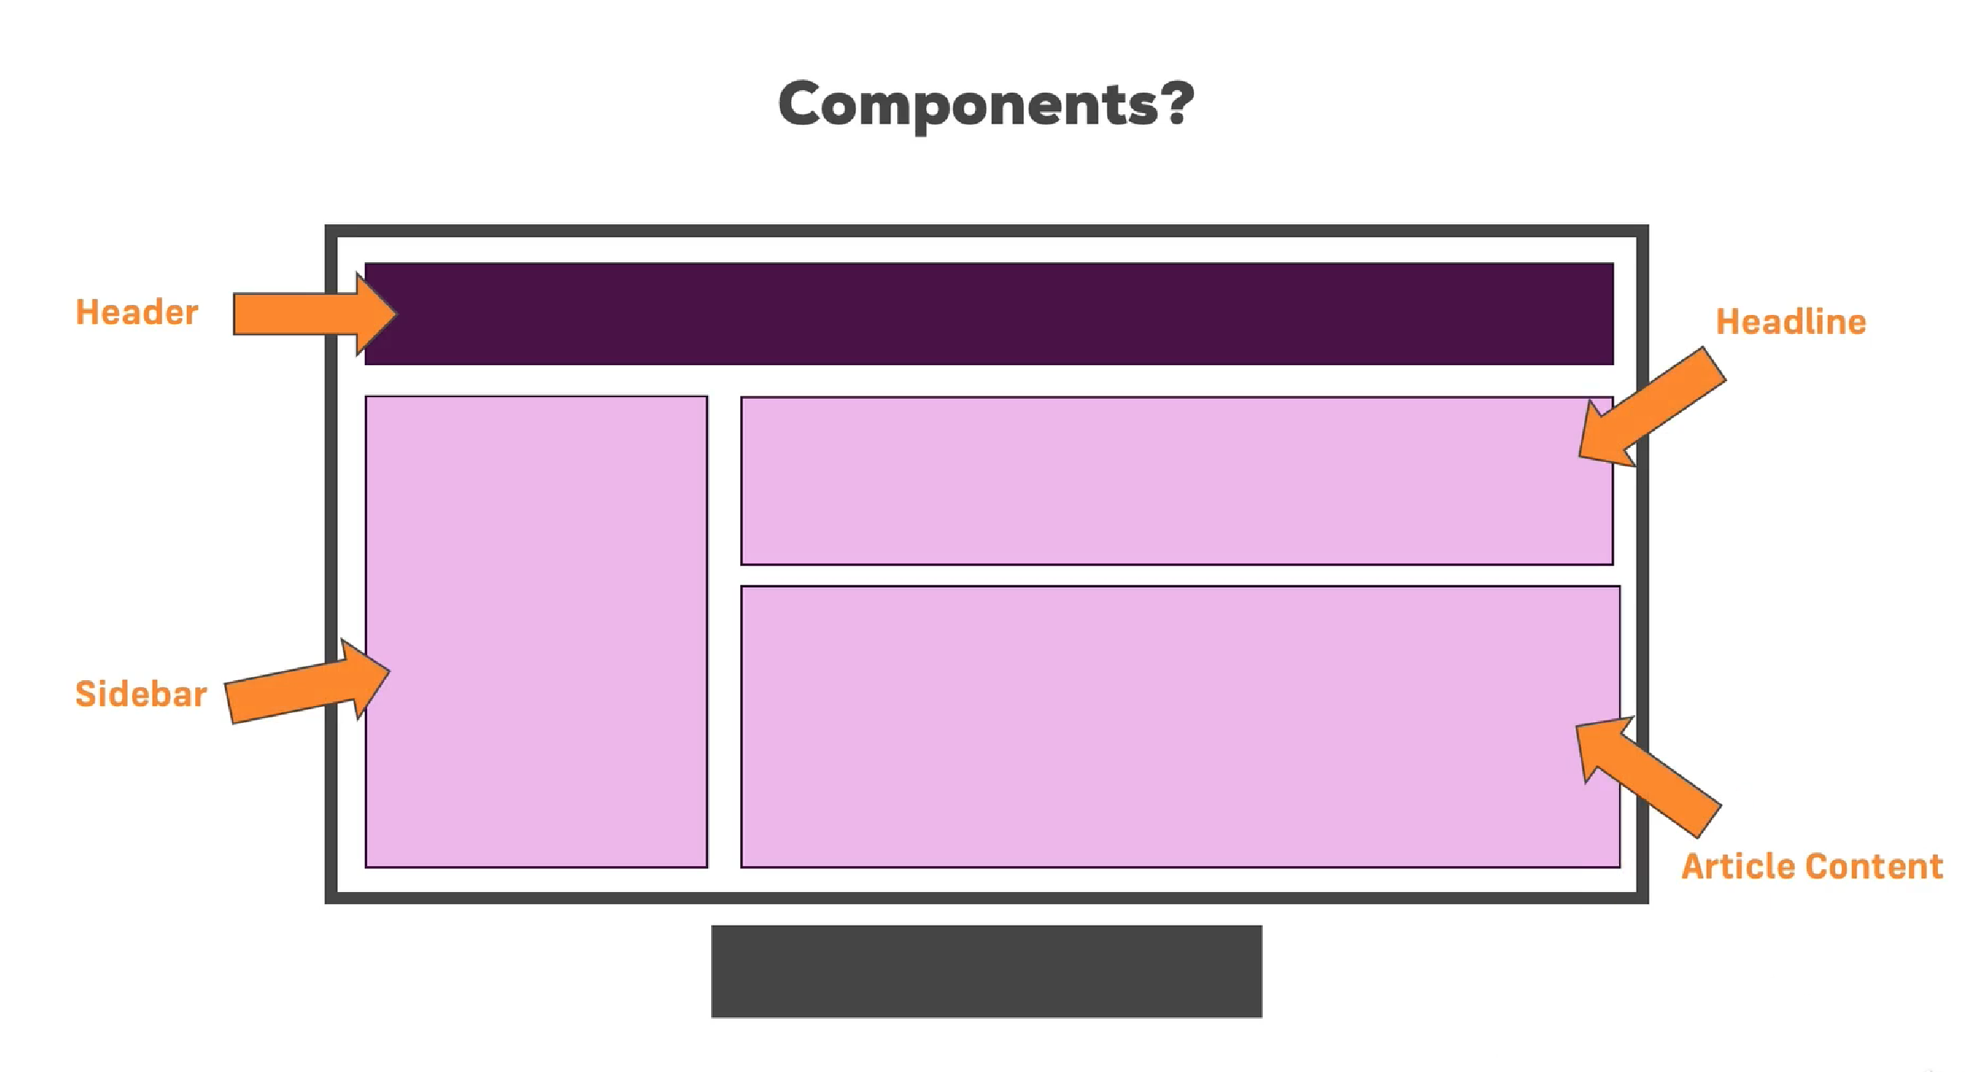
In React, your web page is composed of multiple components.

Slide 6
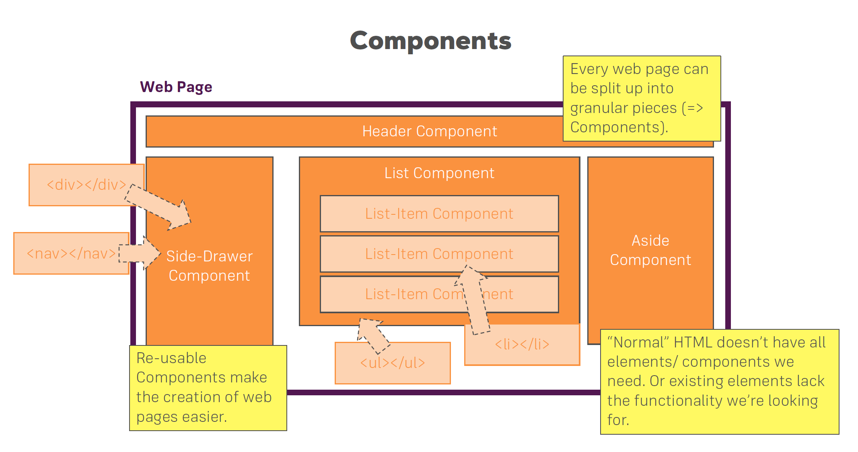

Slide 7
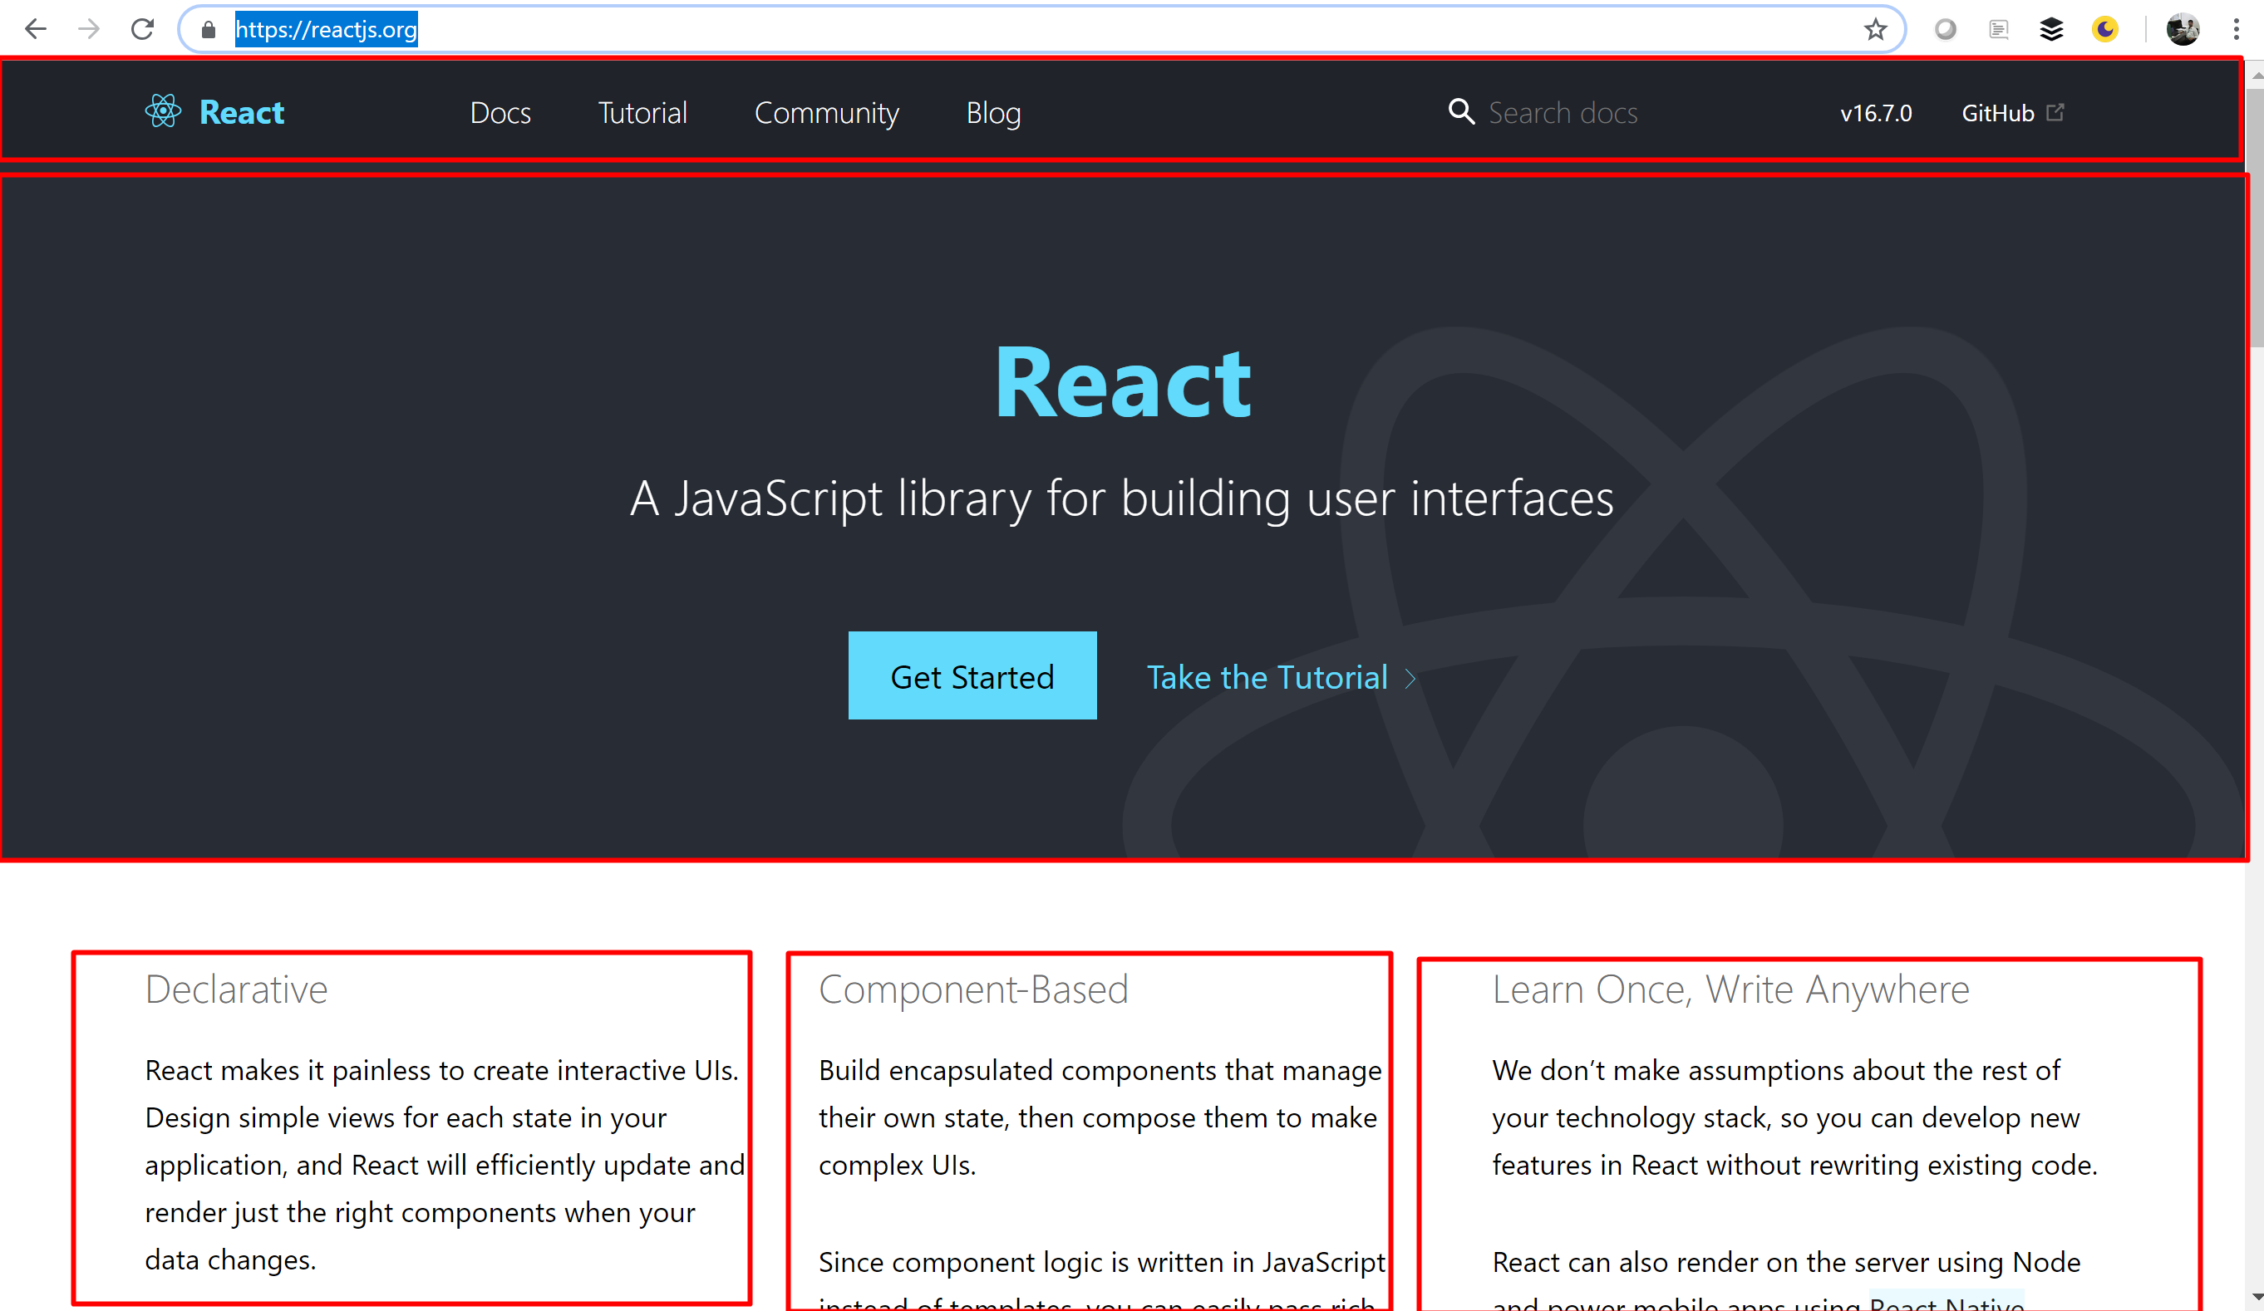
https://reactjs.org/

Slide 8
Why React?
UI State becomes difficult to handle with Vanilla JavaScript
Focus on Business Logic, not on preventing your app from exploding
Huge Ecosystem, Active Community, High Performance

Slide 9
CodePen demo…
https://codepen.io/anon/pen/MELQaQ

Slide 10
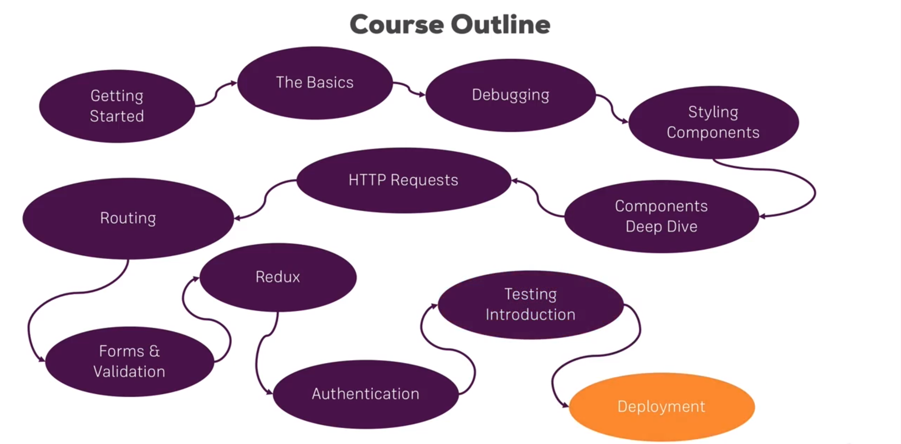

Slide 11
ES 6 → Next Generation JavaScript or OOJ

Slide 12
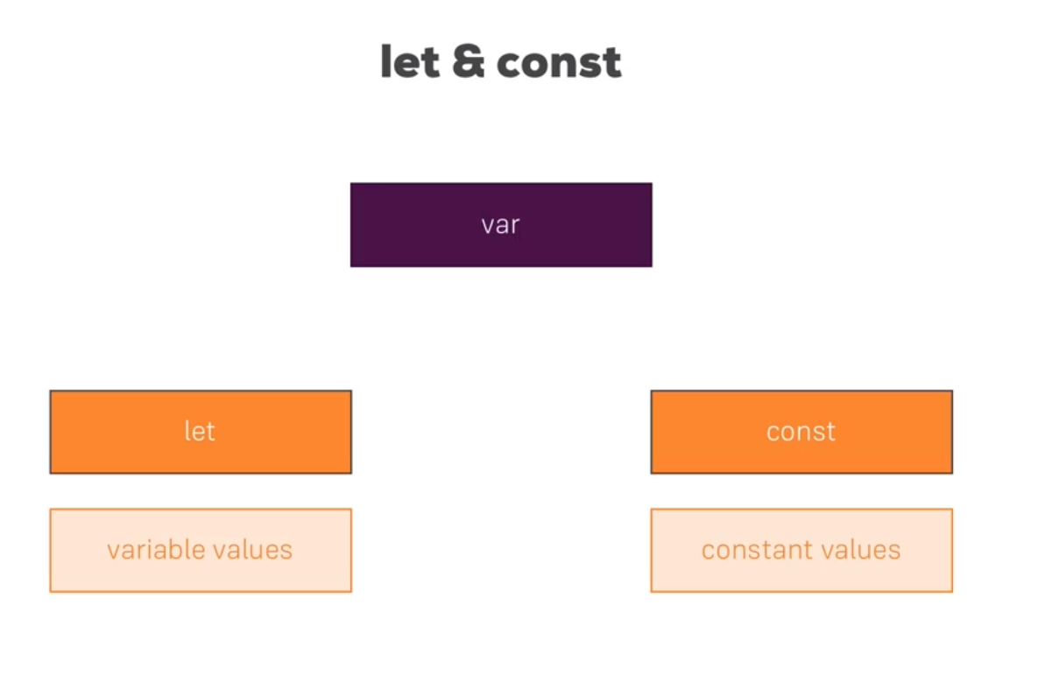
let and const

Slide 13
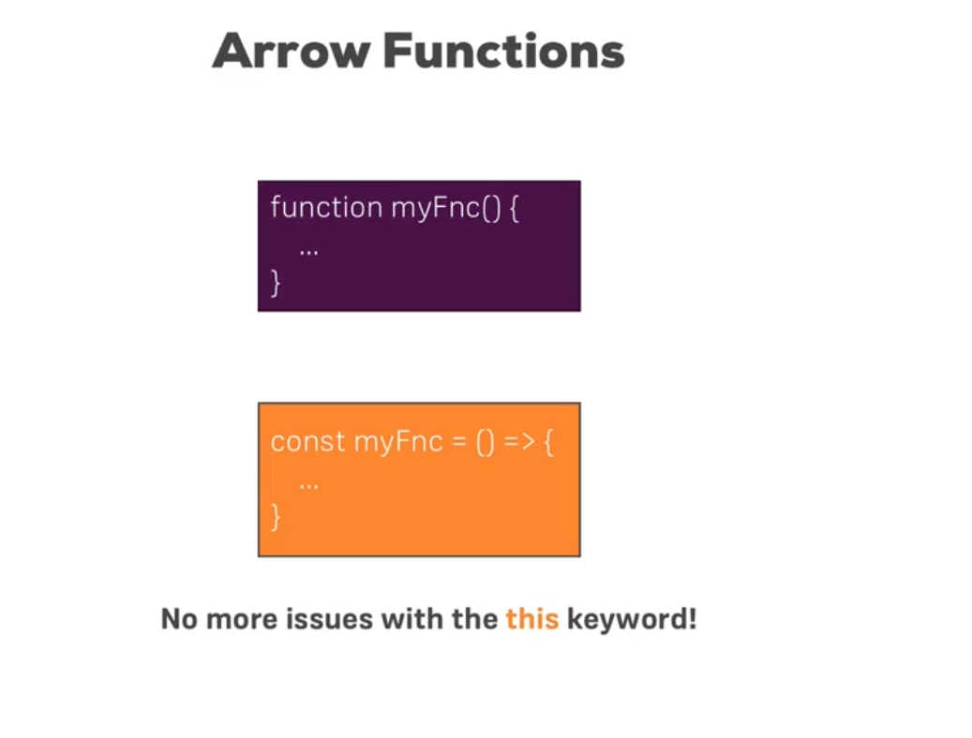

Slide 14
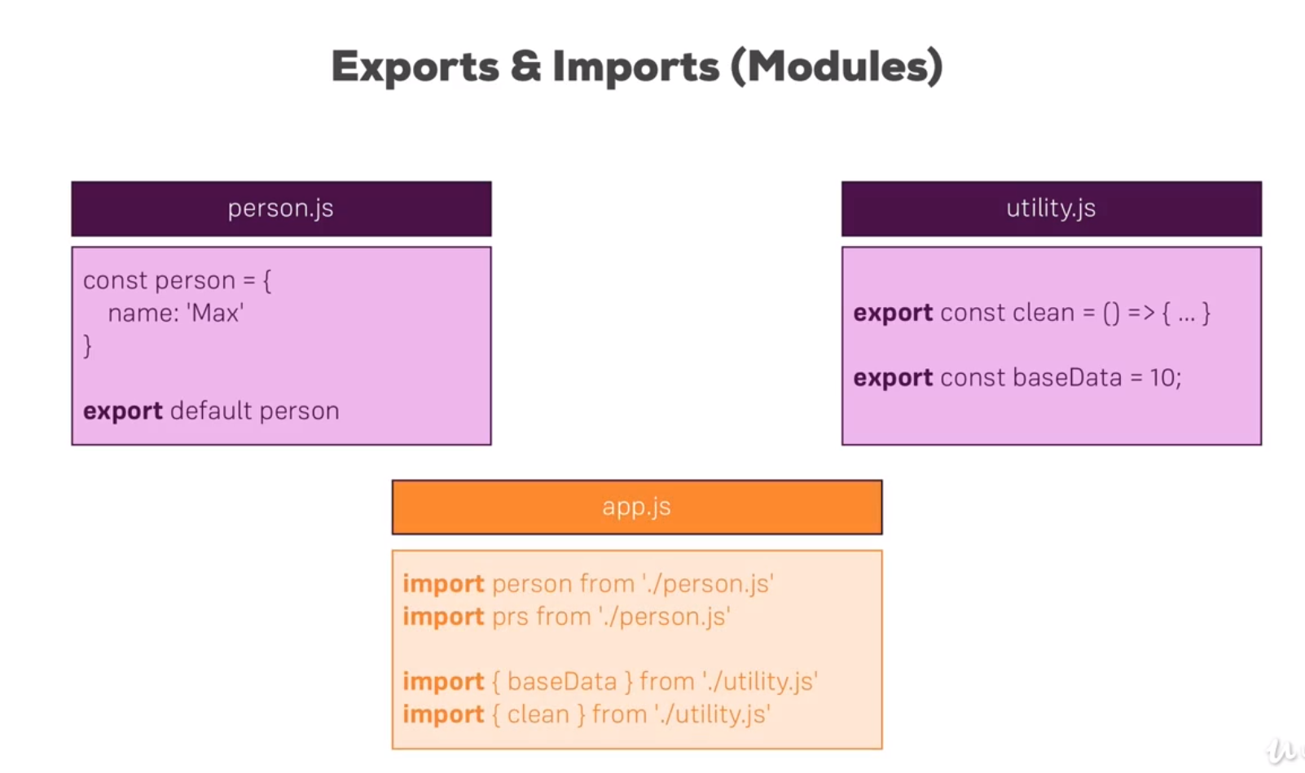

Slide 15
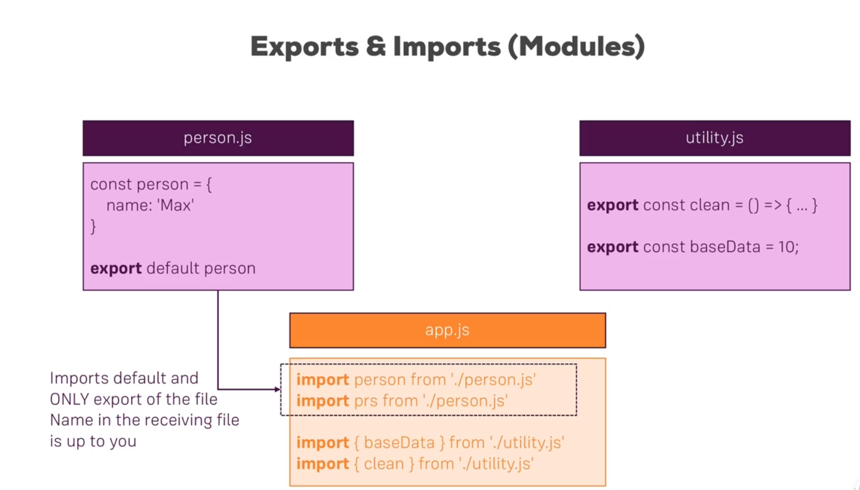

Slide 16
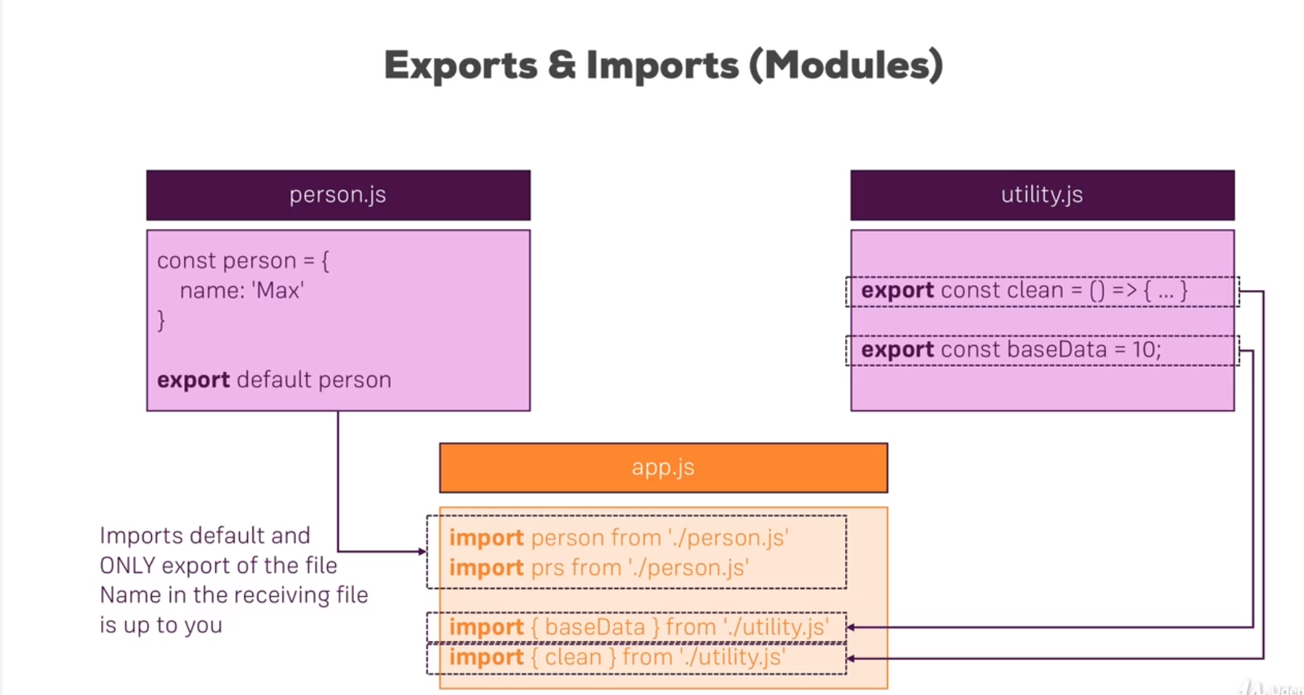
Named Imports. For Named imports we always have to use {}

Slide 17
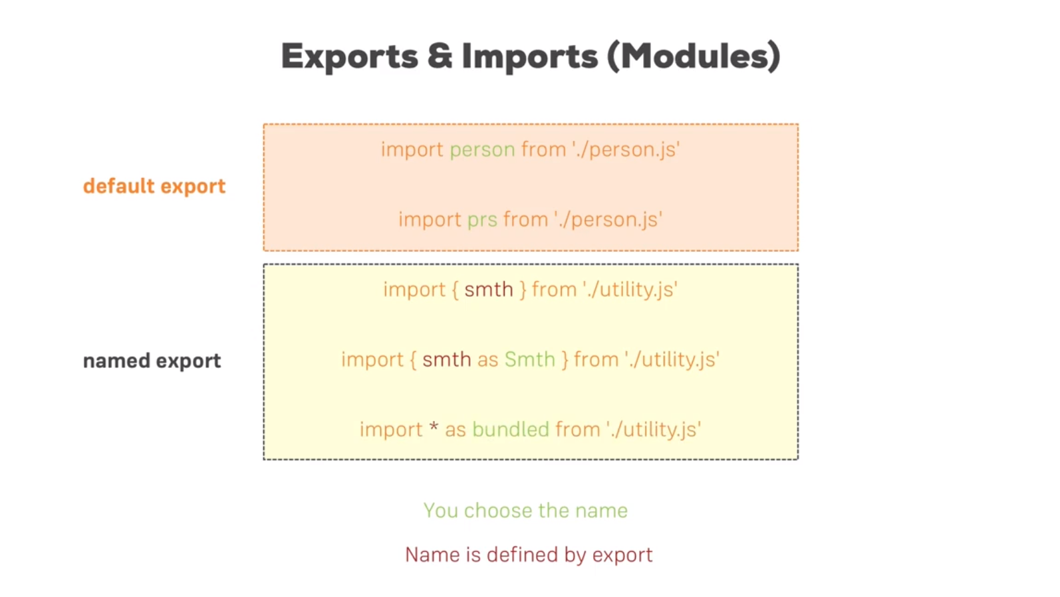

Slide 18
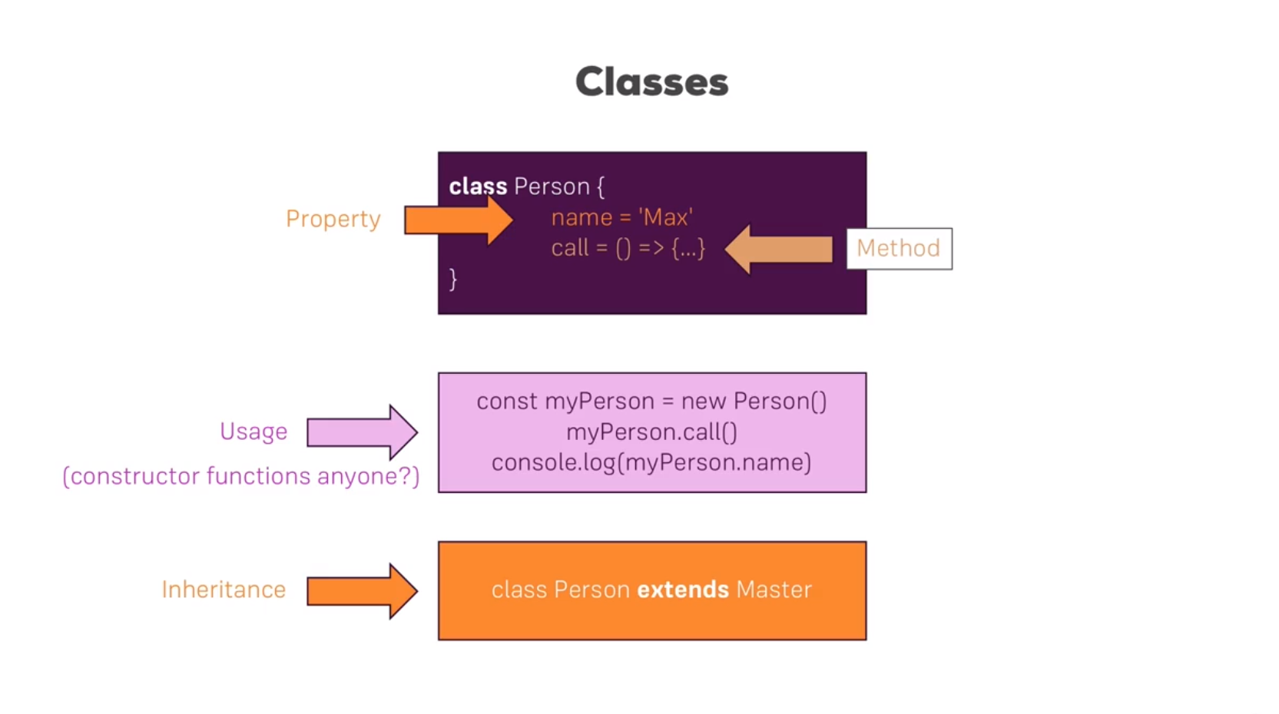

Slide 19
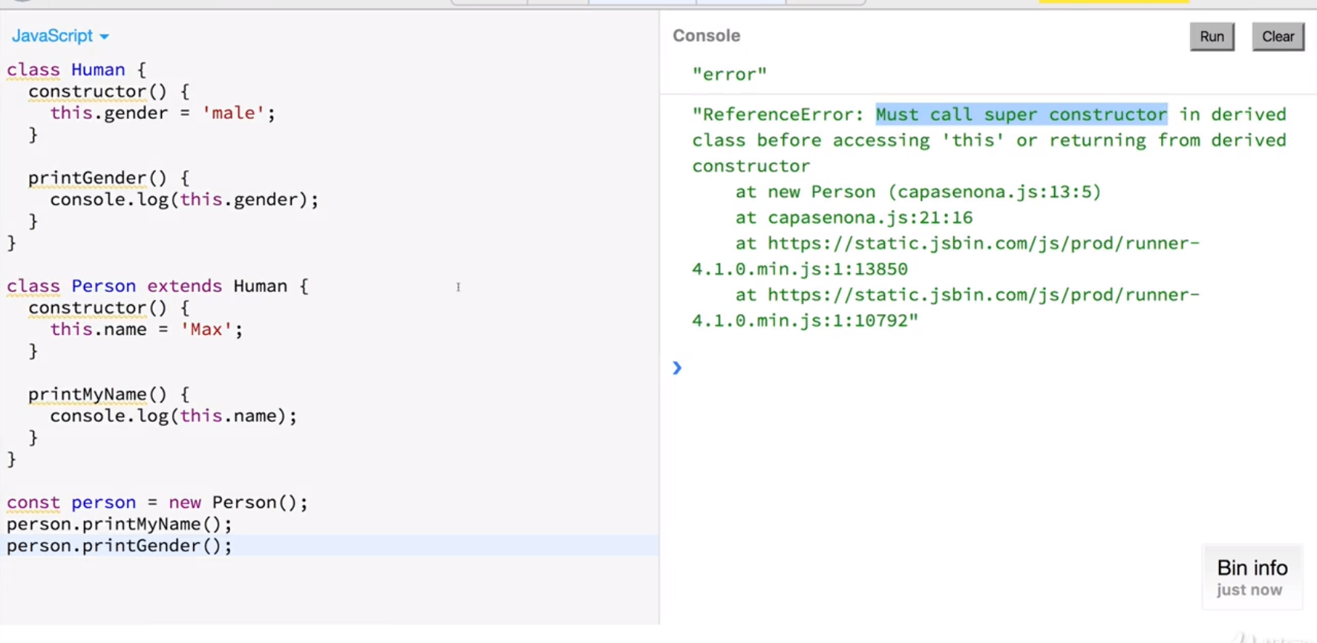

Slide 20
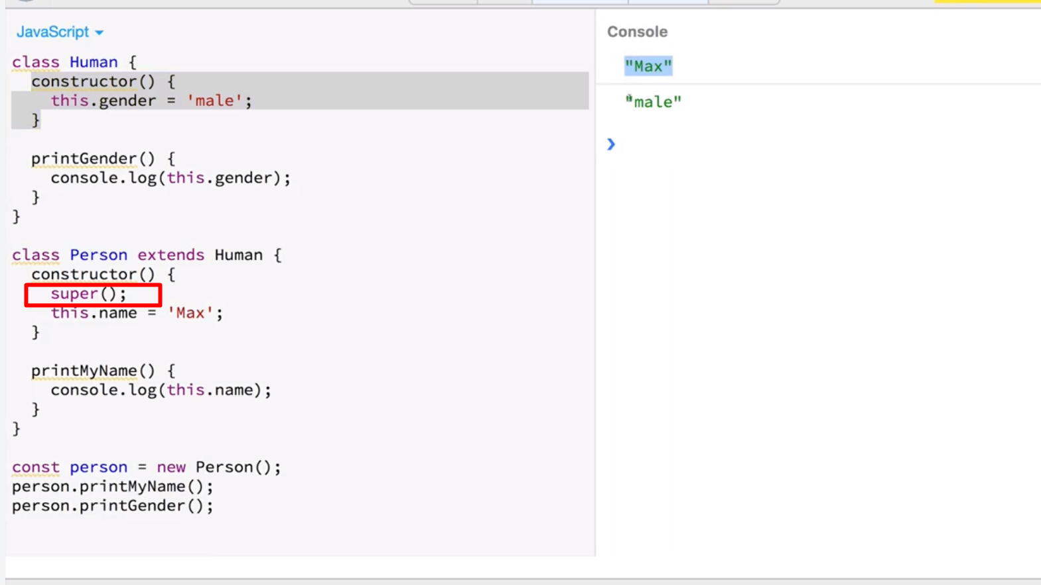

Slide 21
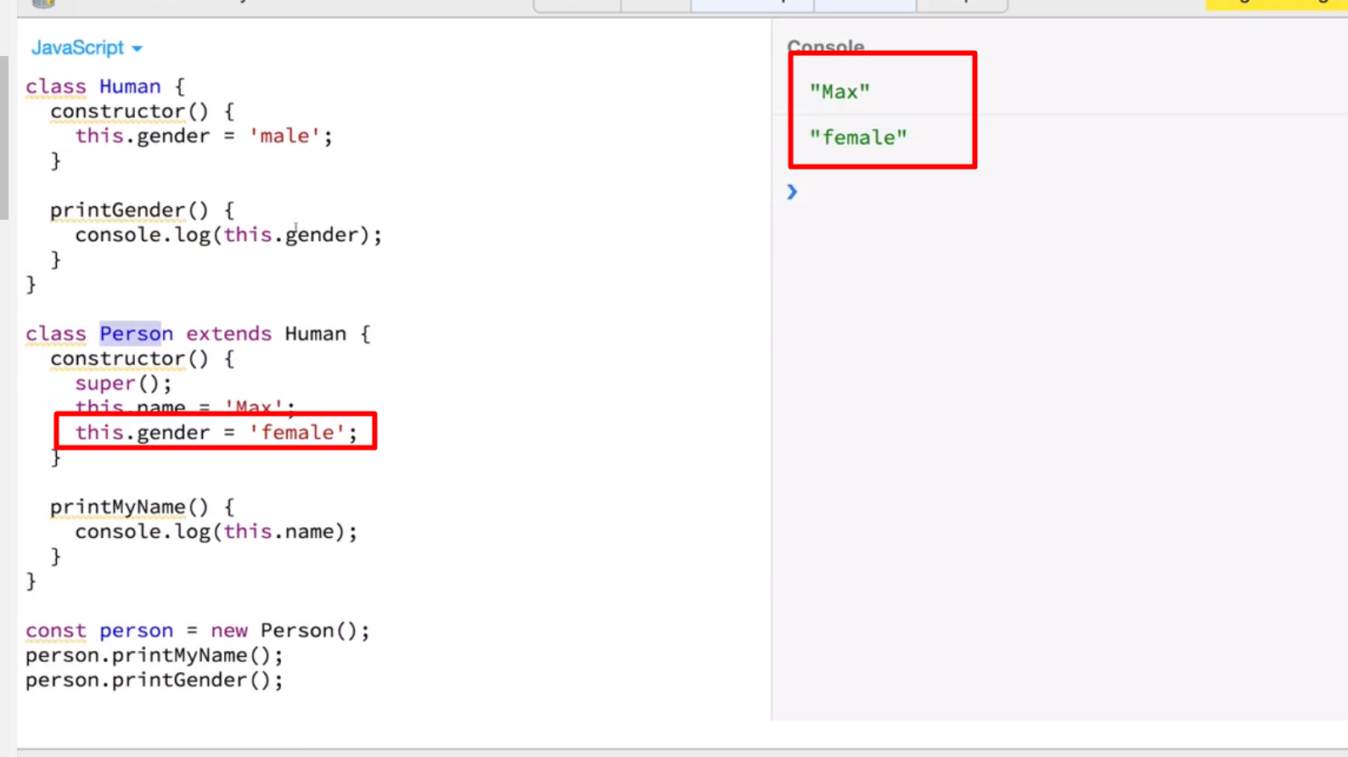

Slide 22
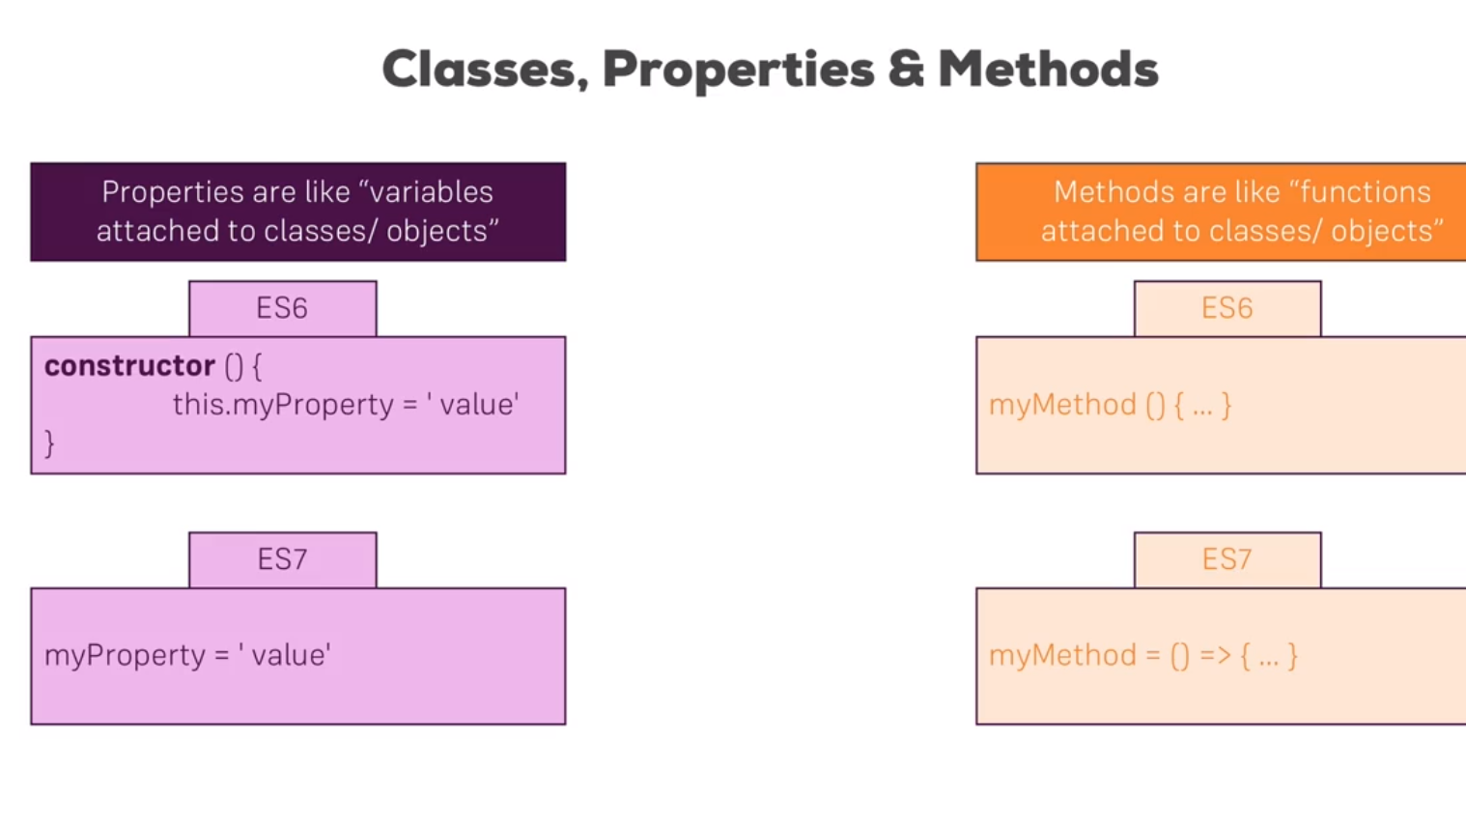

Slide 23
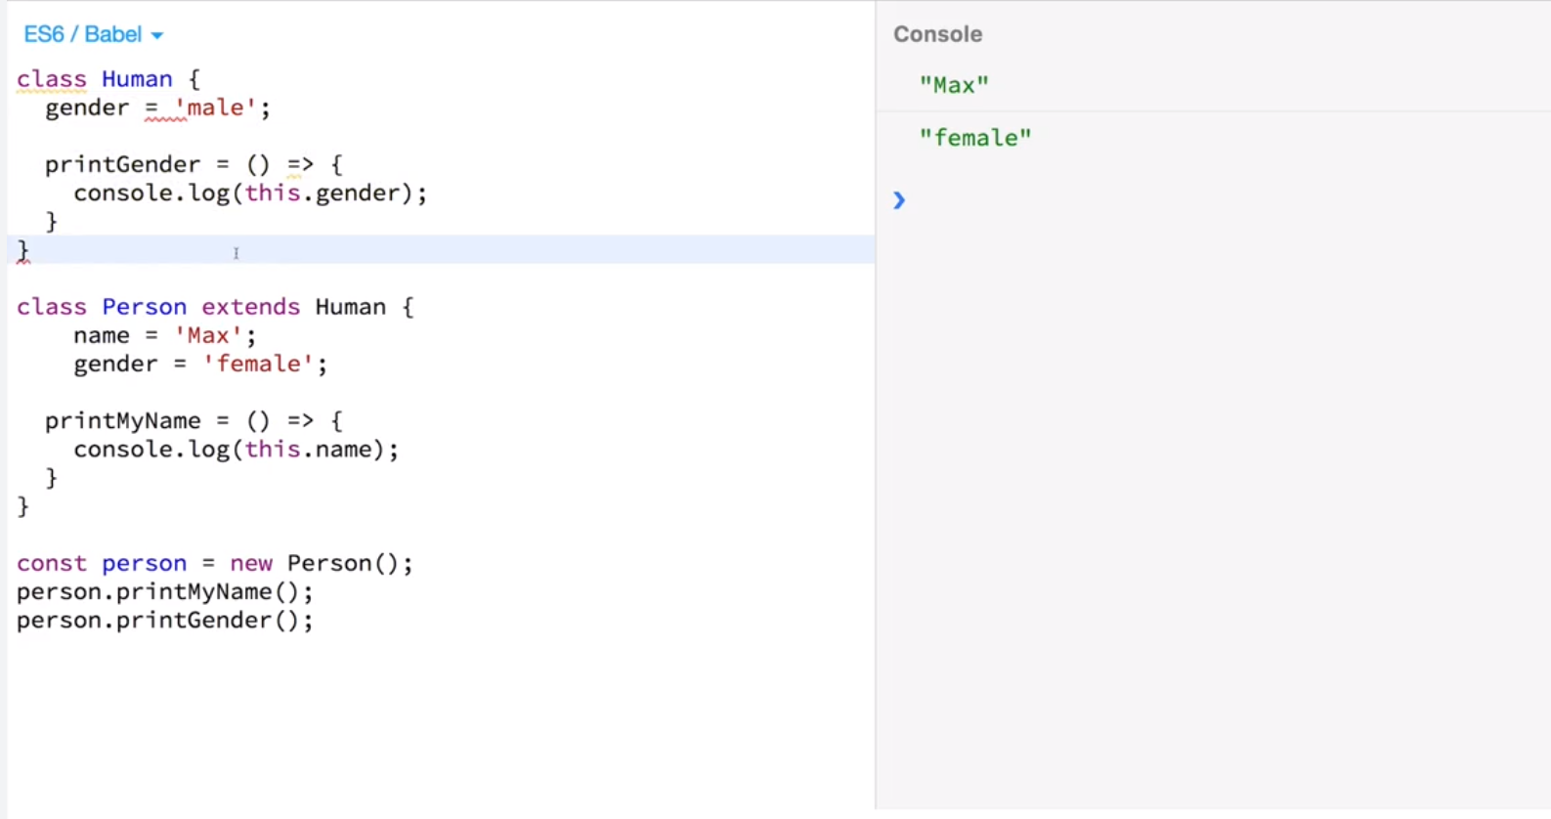

Slide 24
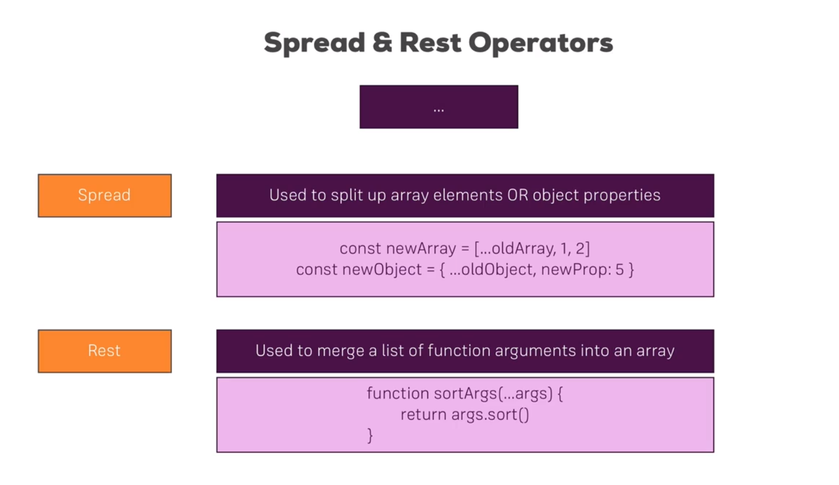

Slide 25
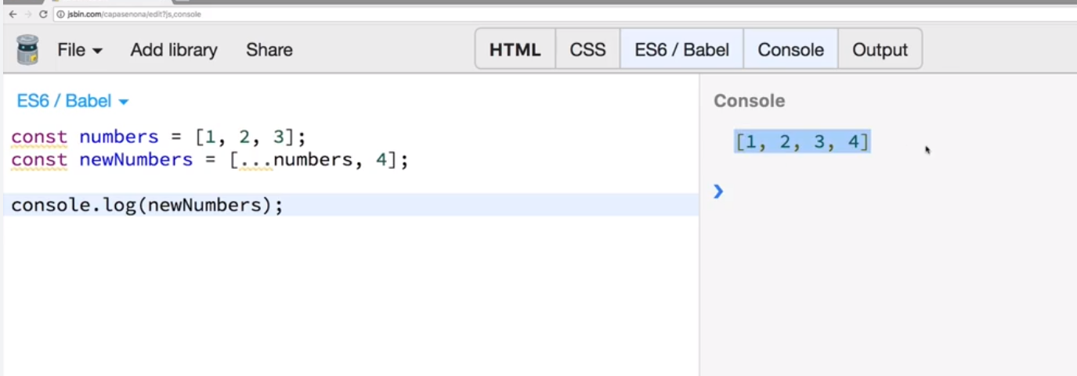

Slide 26
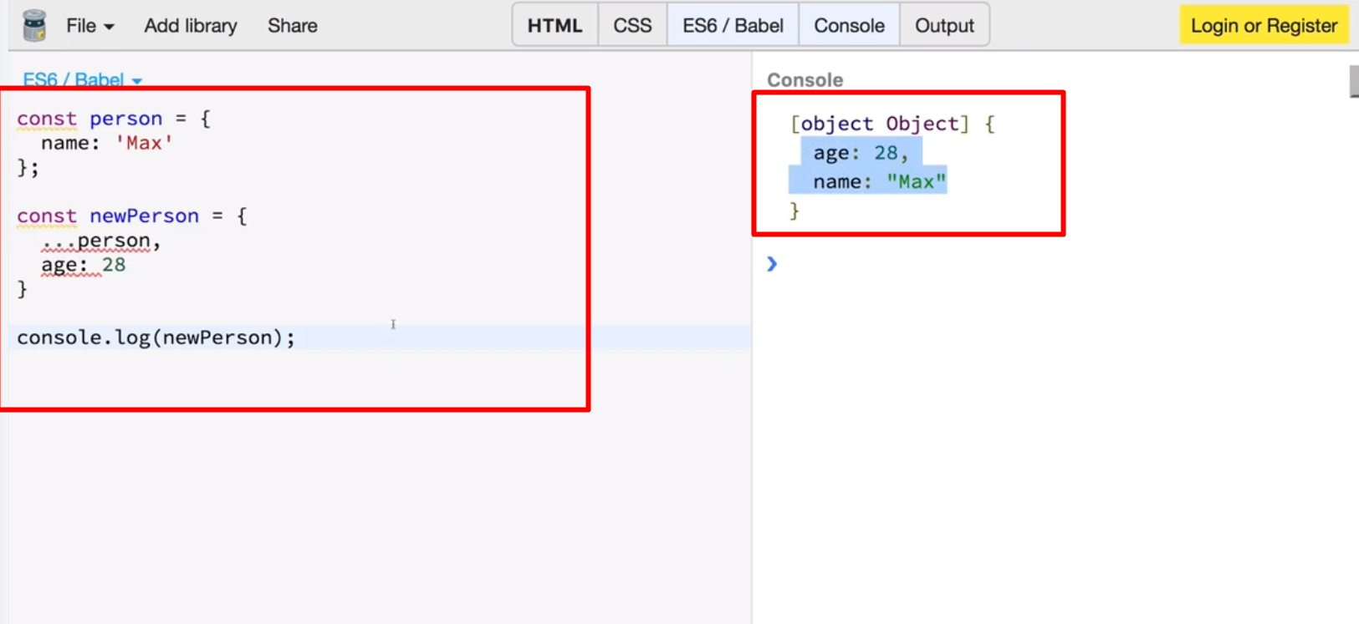

Slide 27
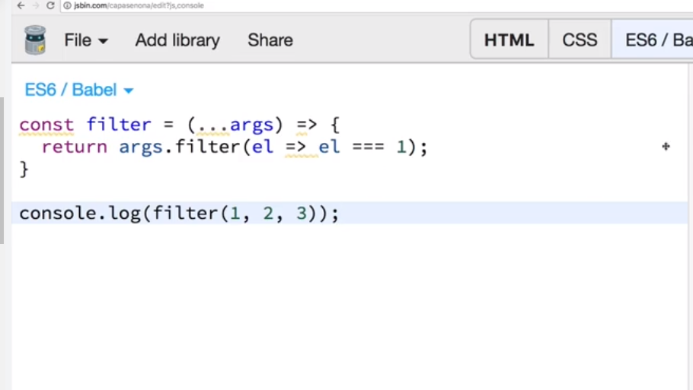

Slide 28
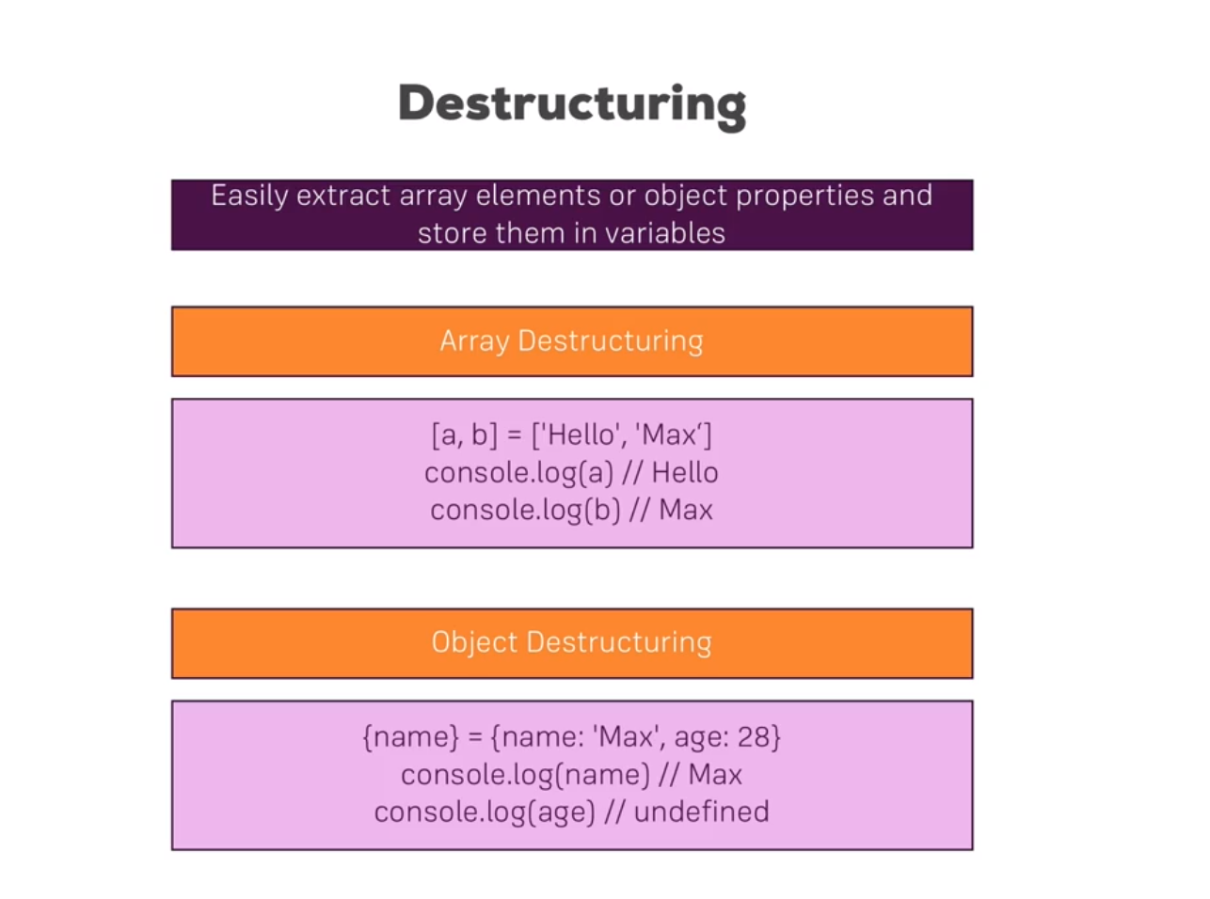

Slide 29
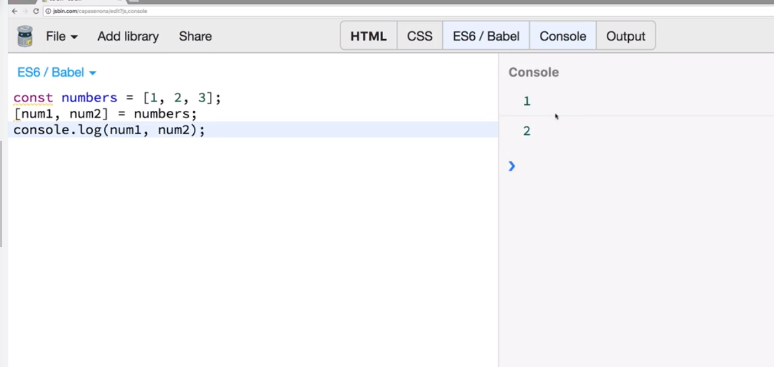

Slide 30
If I create a number like this, then this is a primitive type.
That means if I create a second number num2 and set it equal to this number then it will actually create a real copy of number so num2 of course.Now if I log this, it will also be one.
But it will have copied that value one into num2.
Now numbers, strings, booleans, these are so-called primitive types whenever you reassign or you store a variable in another variable.
It will copy the value, objects and arrays are reference types.

Slide 31
Though let me show you what I mean.I create my personal object which just has a name here and I now create a secondPerson and assigned person as a value here.If I console log.secondPerson and hit run, it will print the same value as the first person but it will not actually have copied the person instead.
Person the object is stored in memory and in the constant person we store a pointer to that place in memory.
And if we then assign person to secondPerson that pointer will be copied.
We can see that this is the case if we changed person.name after having it copied.
With that you would expect to print Max here still a person with name Max because we copied person, stored it in secondPerson and thereafter changed the name.However if I clear and run you will see name.
Manu here even though I'm printing the secondperson so for secondPerson the name also changed the reason for it is that it just copied the pointer and points to the exact same object in memory as person does.

Slide 32
So if we change name on person we automatically change it for secondPerson.
Now that's important.Keep in mind and it's the same for arrays.
If you copy in quotation marks.An array like this.And you then change an array element.It will all change in the so-called copied array.
This will become important in React because it can lead to unexpected behaviors.
If you copy objects or arrays like this because you then may manipulate one object in one place in the app and accidentally manipulate another usage of the same object in another place of the app.
Therefore we will learn techniques to copy this in an immutable way which means we copy that by really copying the object and not just a pointer for that we can use this spread operator.

Slide 33
Now we can simply create a new person object here and spread the person properties. This will pull out the properties and the values of the properties from the object and add it to thisnewly created object here and we do create a new one with the curly braces.
Now if I hit clear and run we still print an object with name Max even though we changed the name to Manu here because now we really created a real copy.
This is a technique I will also come back to later in this course.
It's just important to realize and to keep in mind that objects and arrays are reference types.If you reassign them you're copying the pointer not the value.
Therefore if you want to do this in a real copy way, you will have to create a new object and just copy the properties and not the entire object.

Slide 34
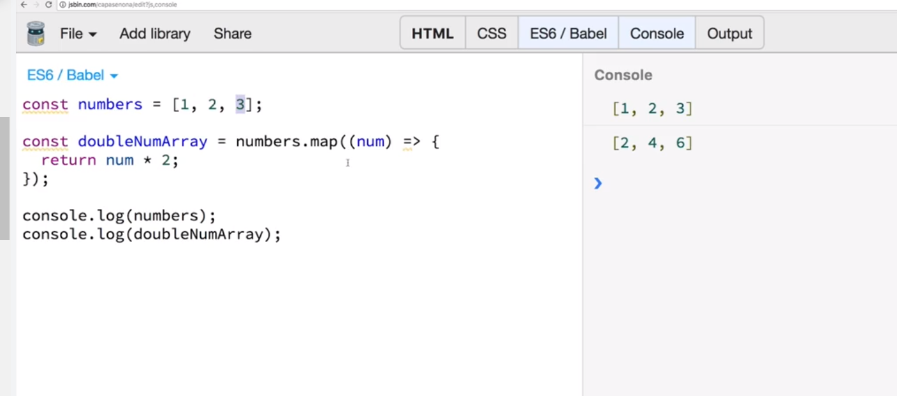
Refreshing array functions

Slide 35
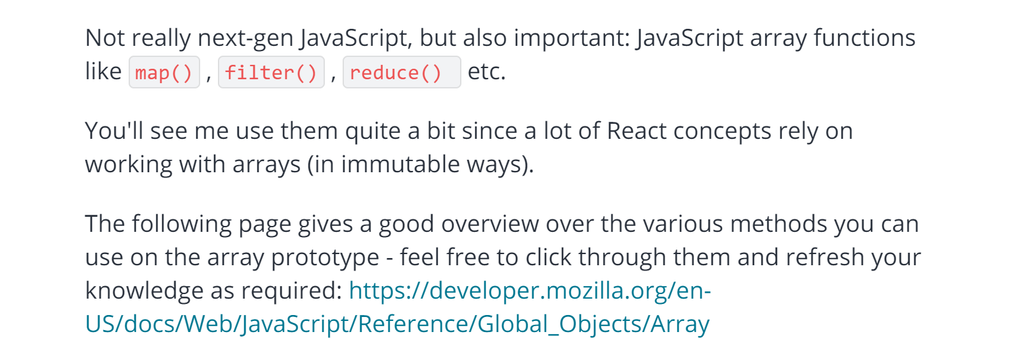
JS Array Function

Slide 36
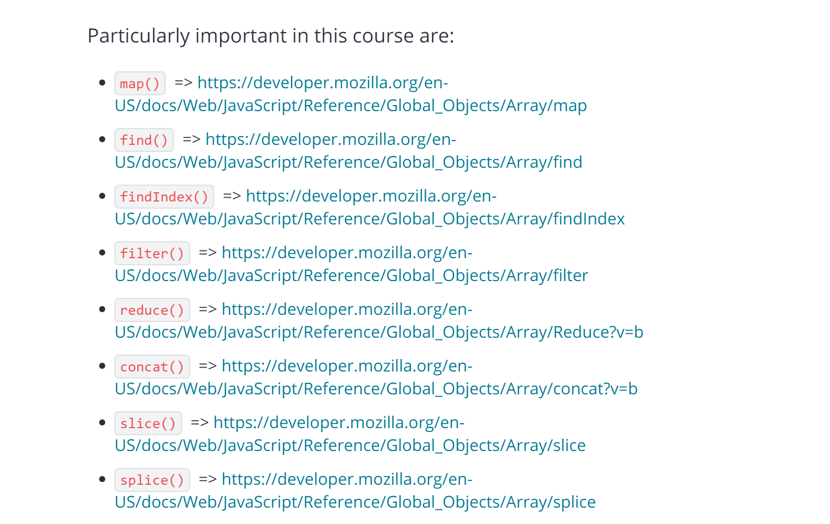

Slide 37
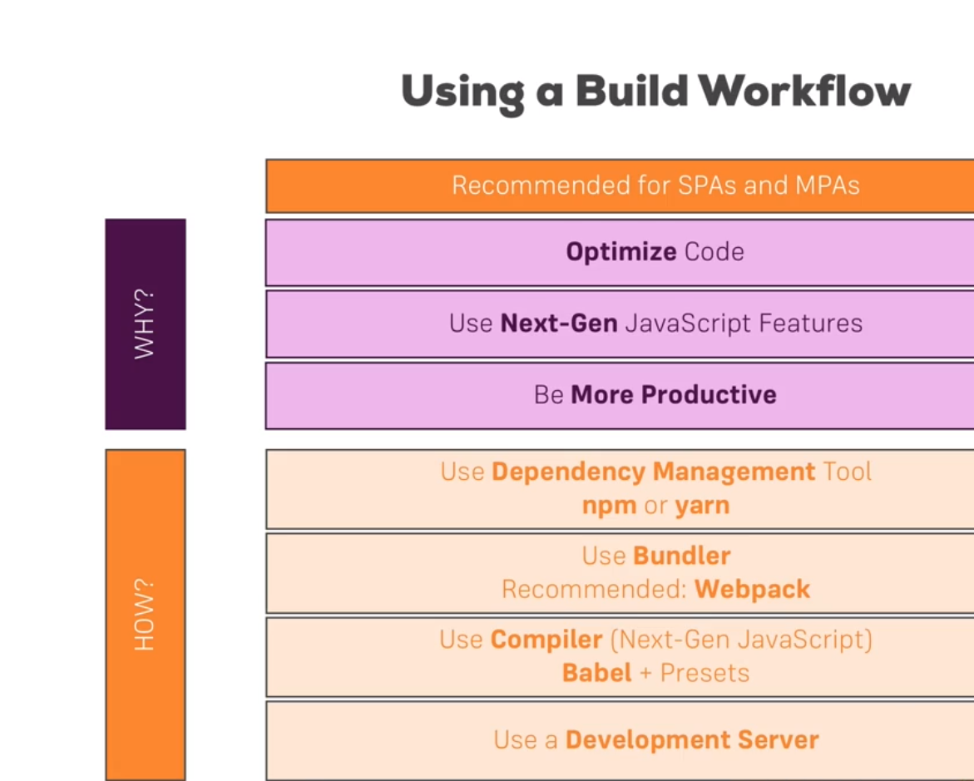
Tools/Pacakges/Library we need to work with React

Slide 38
We can also use React CLI or say React App tool…it is an official tool to create any React App
Open a Link :
https://github.com/facebook/create-react-app

Slide 39
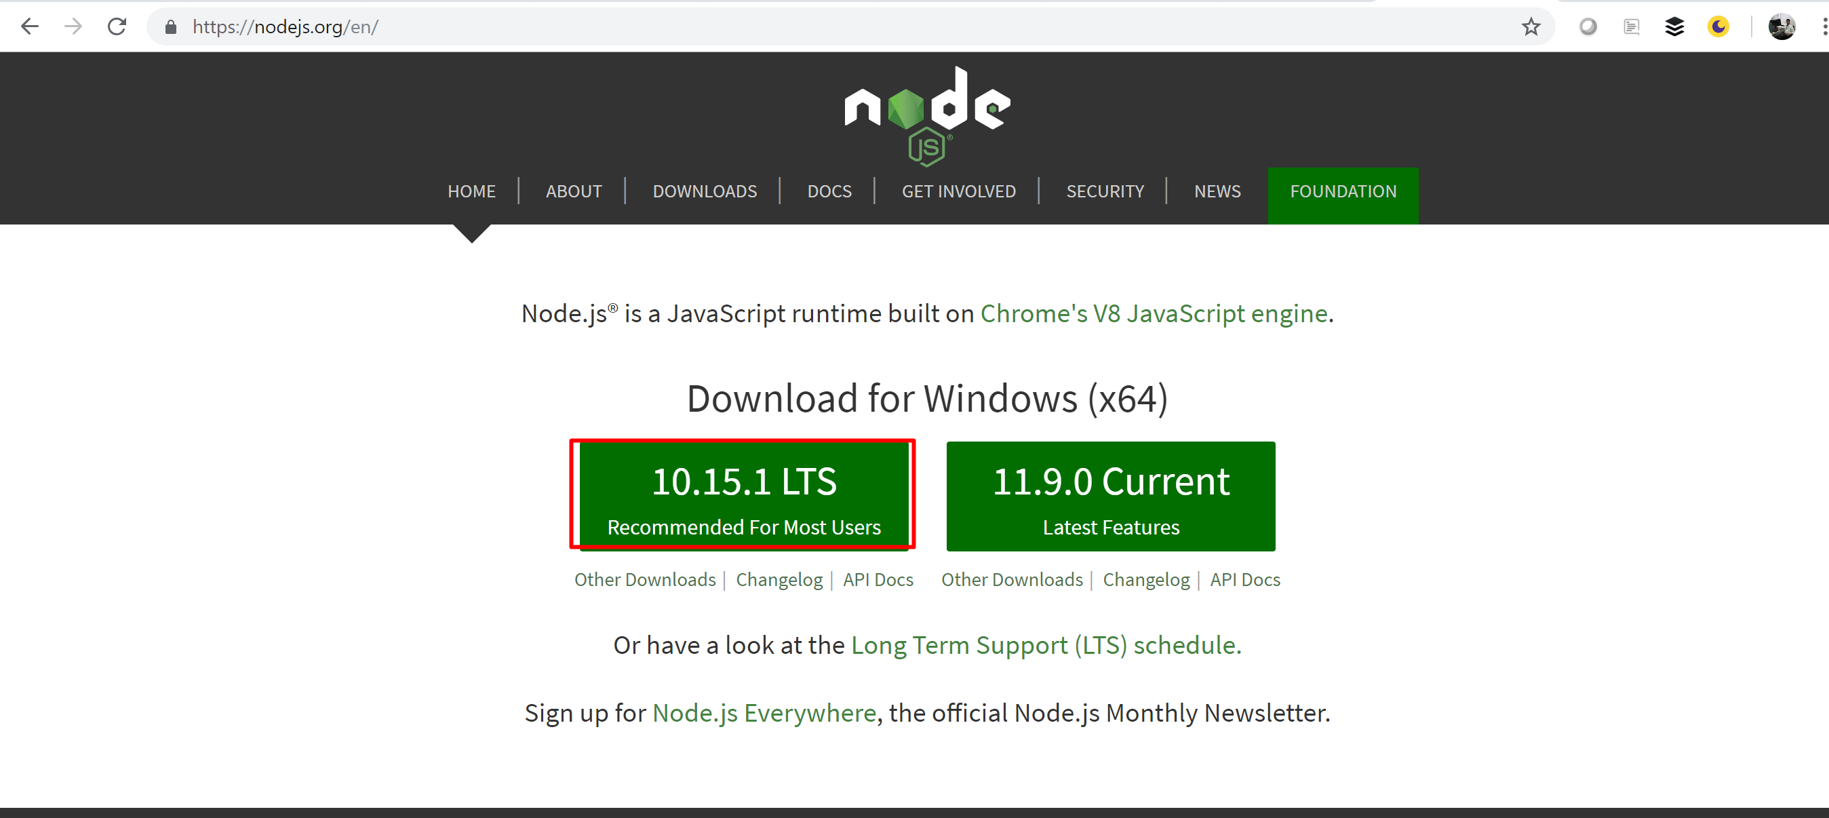
Development Environment SetUp

Slide 40
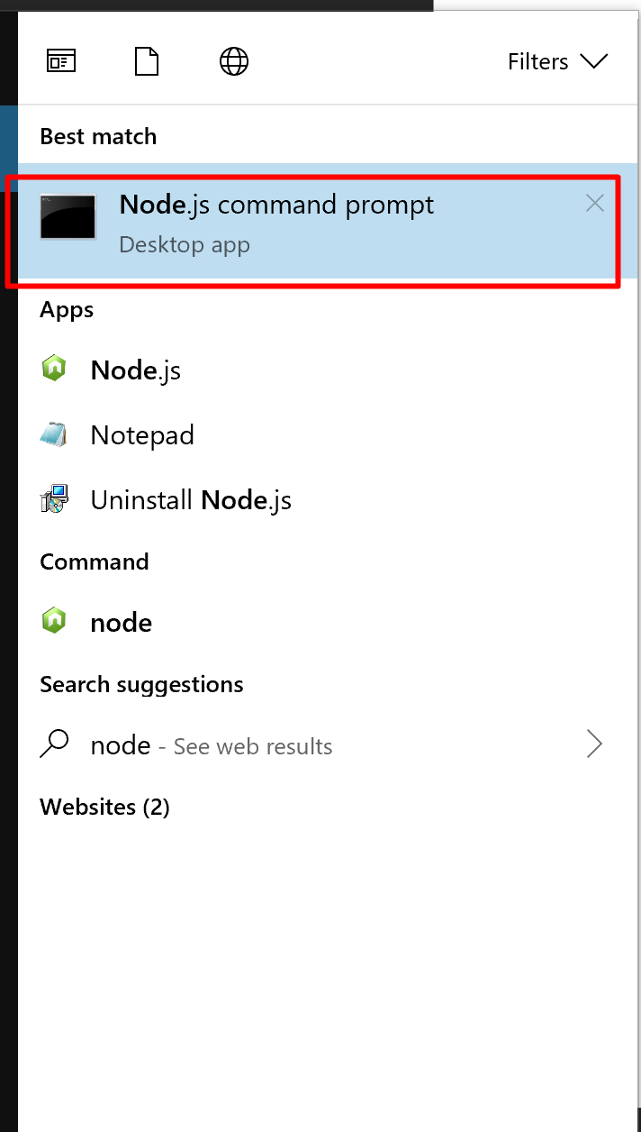

Slide 41
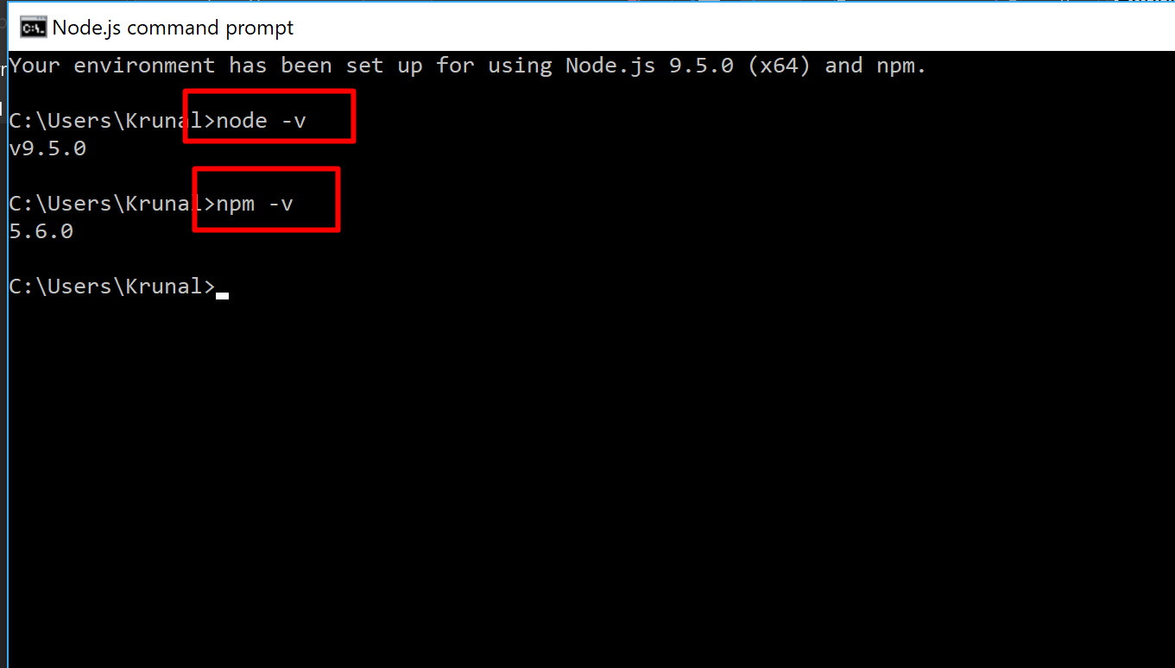

Slide 42
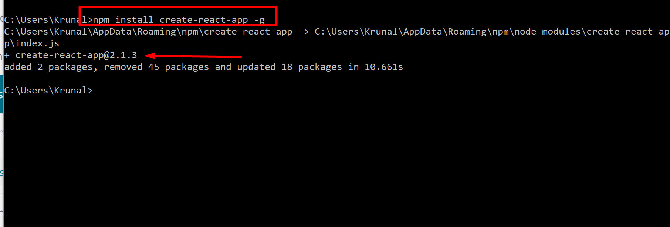

Slide 43
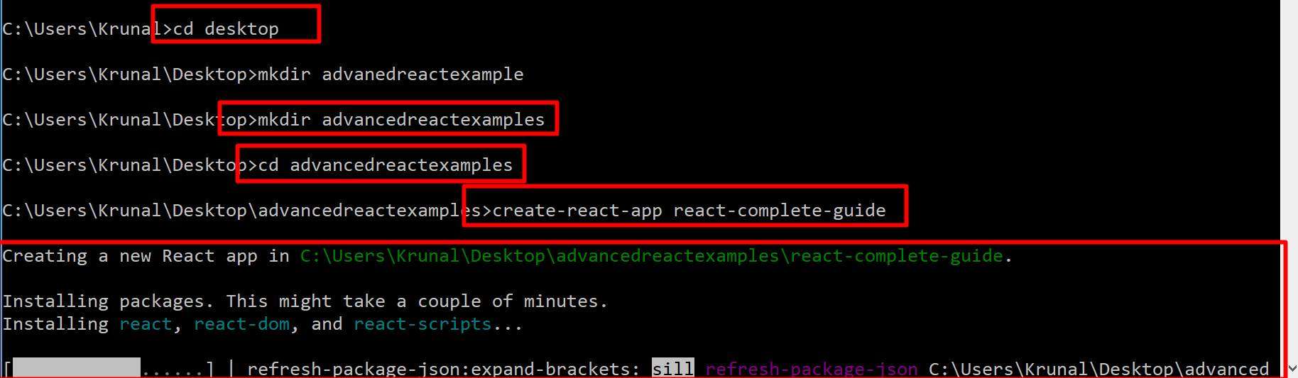

Slide 44
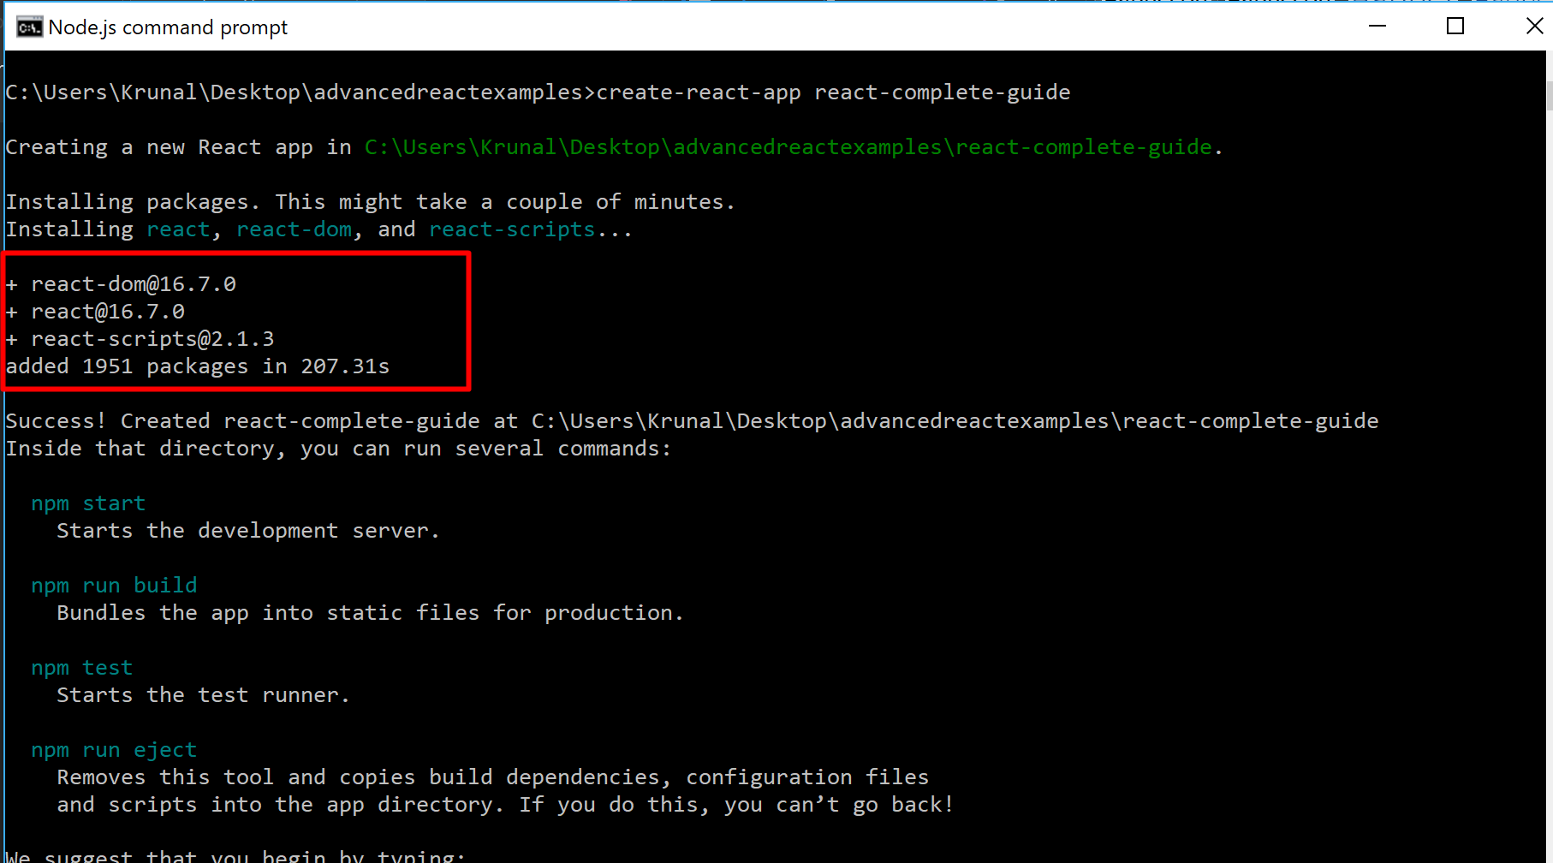

Slide 45
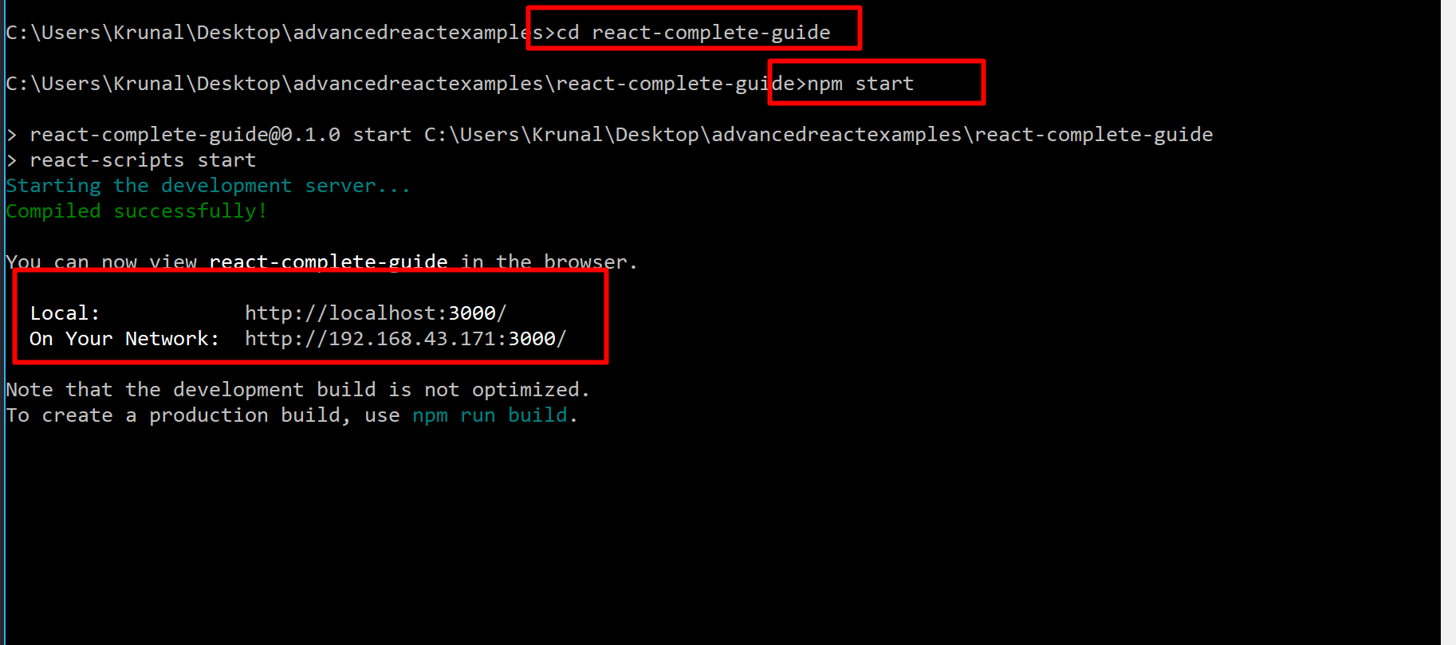

Slide 46
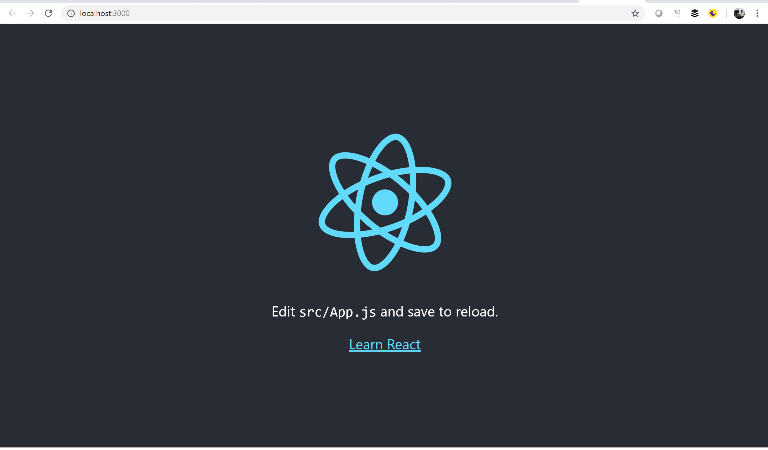

Slide 47
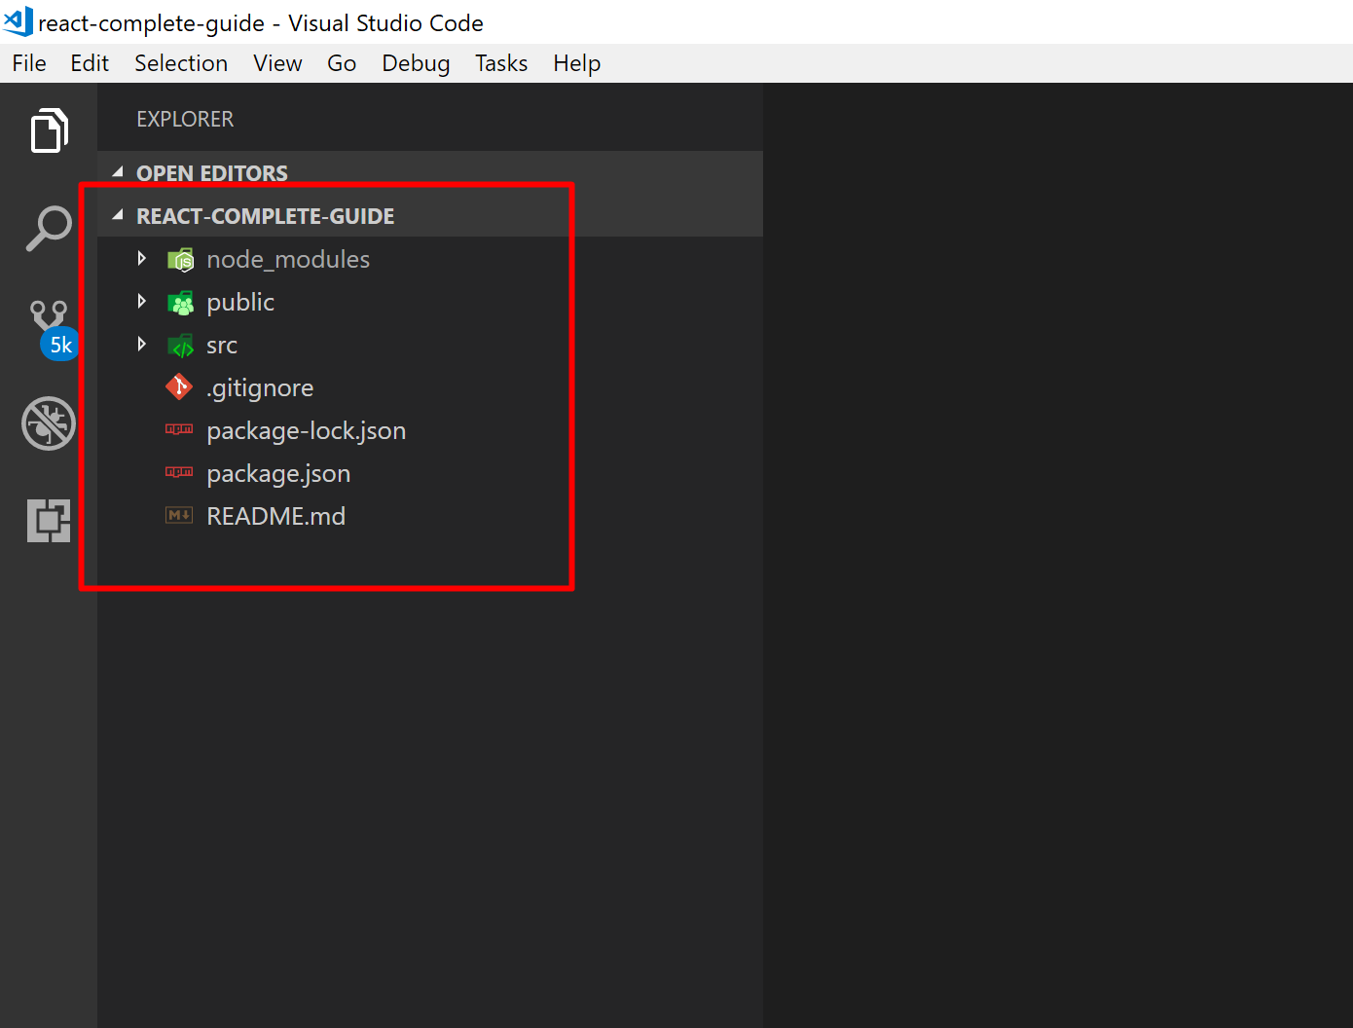
You can see the folder structure of your project. My VS Code theme is Dark (Default).

Slide 48
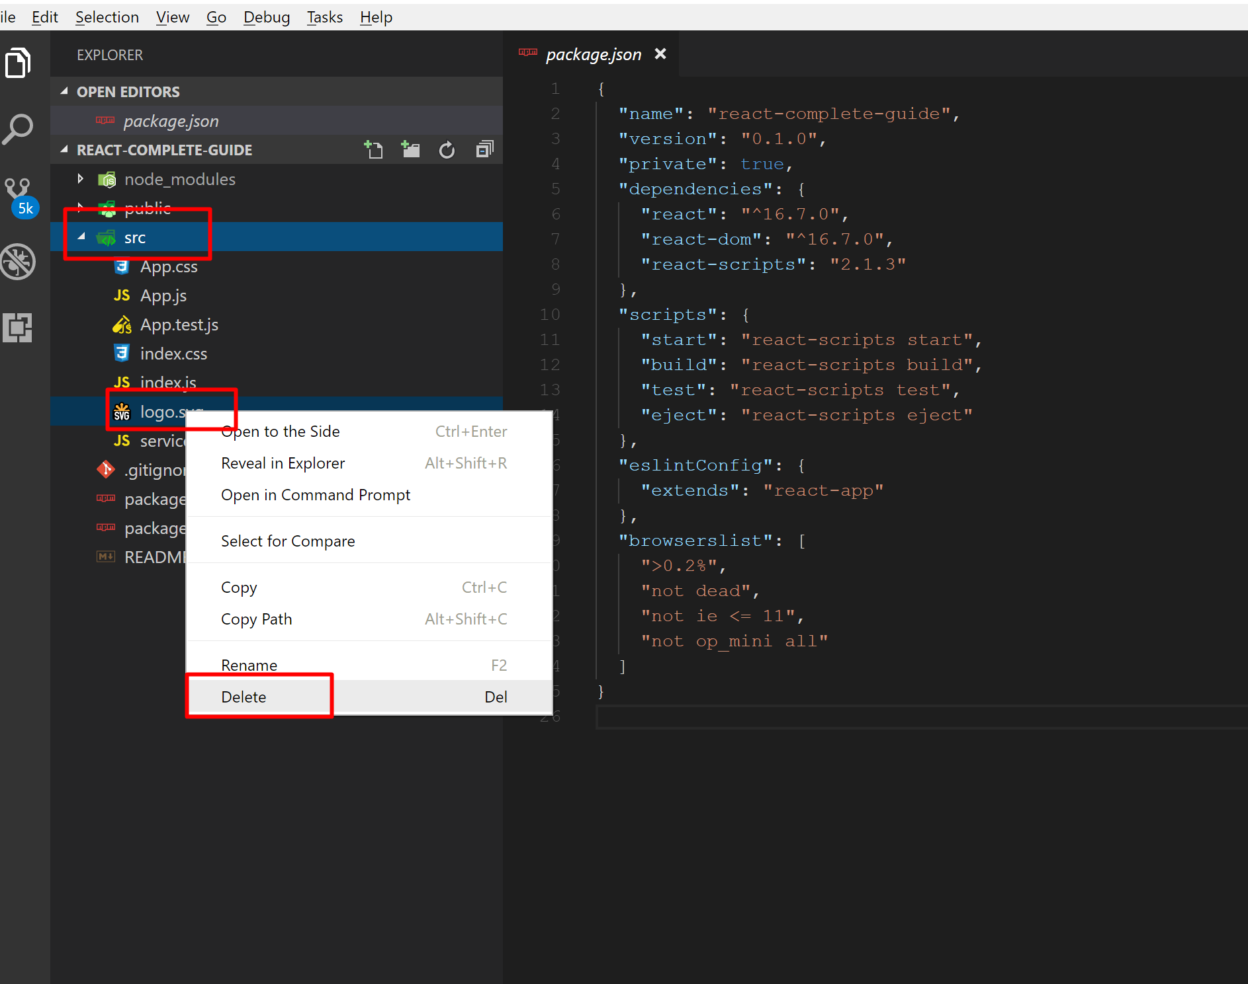
Go to Src folder→ Delete logo.svg file

Slide 49
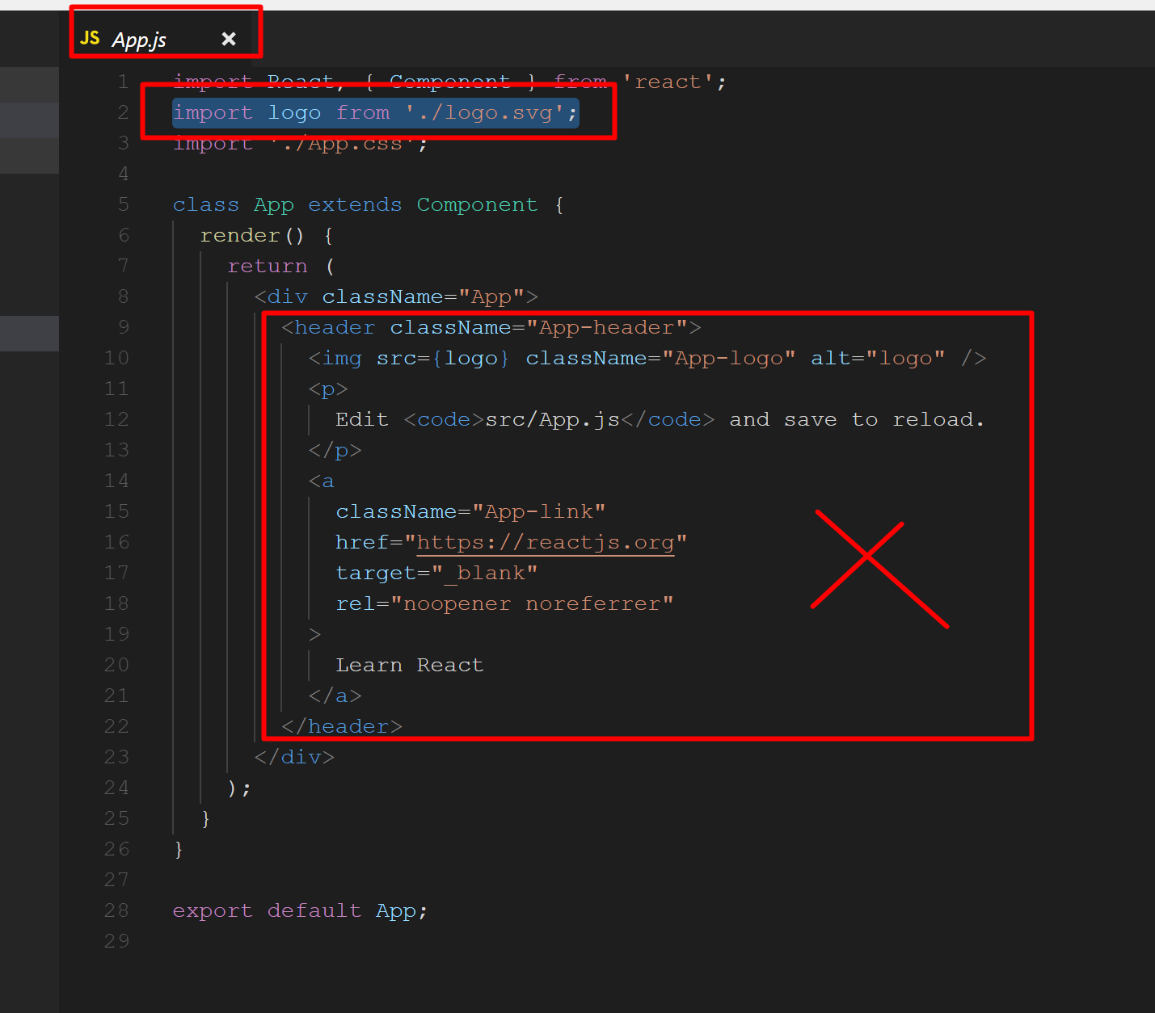
Also delete the import statement from the App.js file and remove the code within div element within return function.

Slide 50
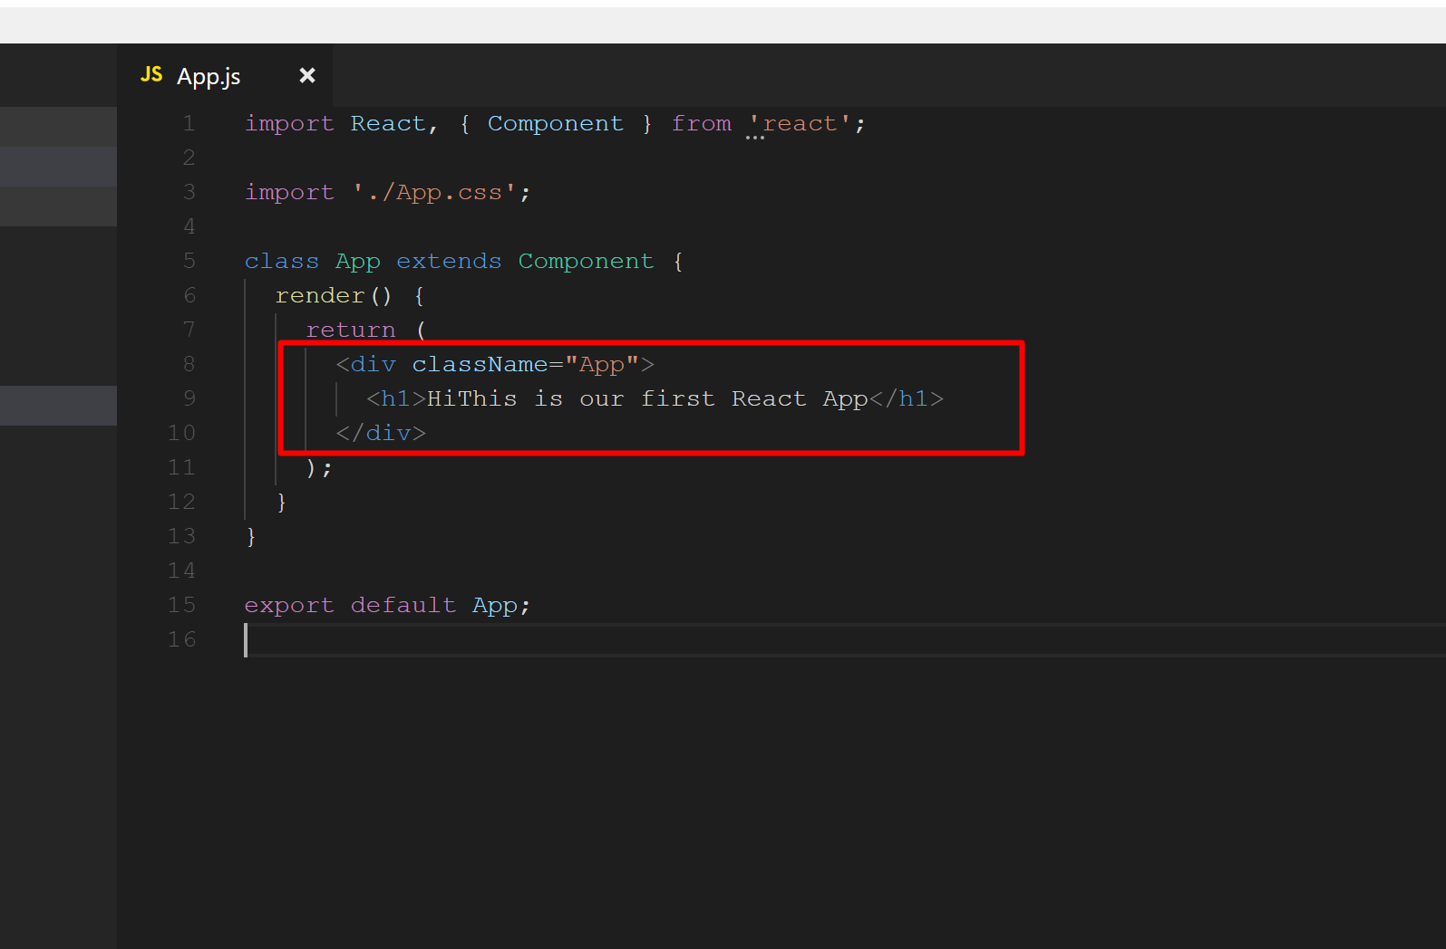
App.js → Add an <h1></h1> element.

Slide 51
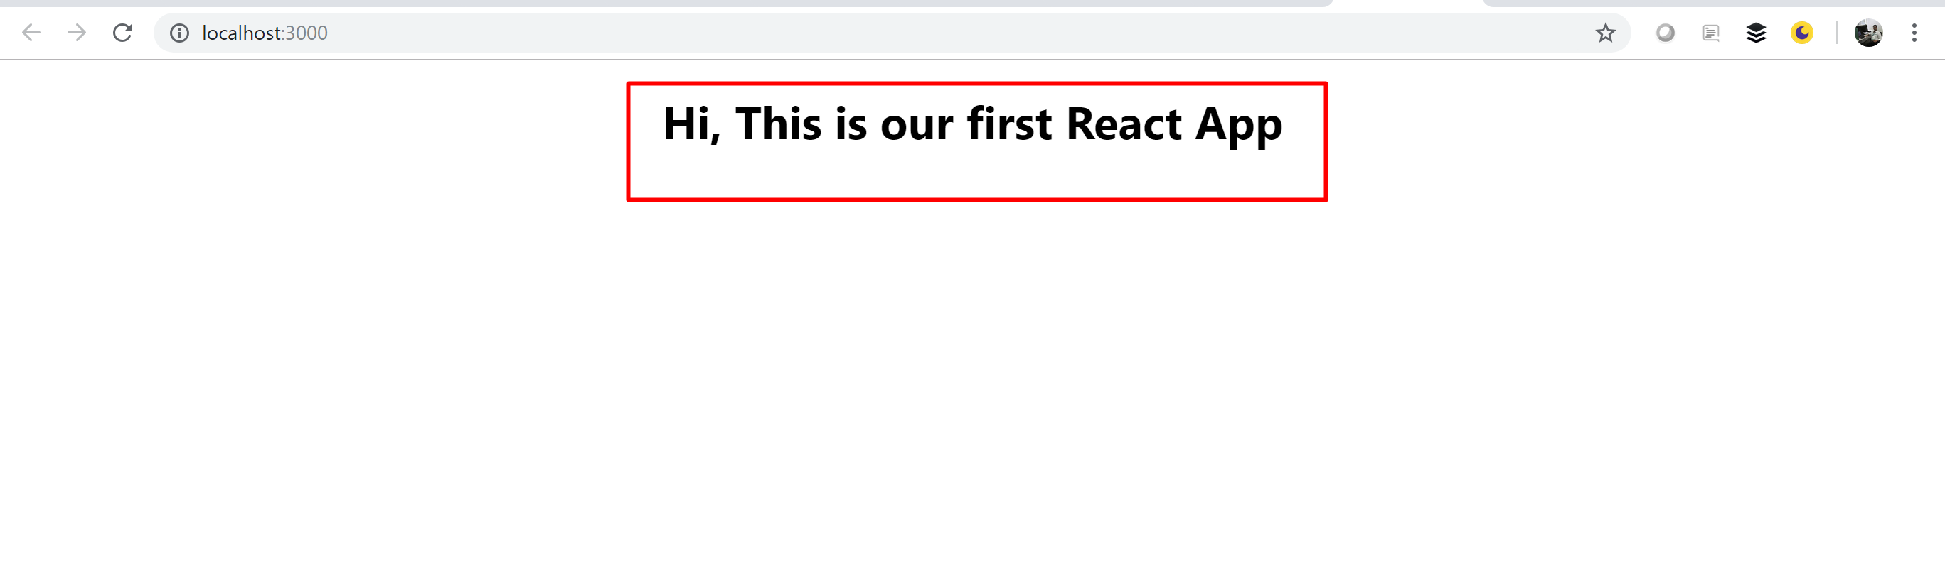
If you run the app, it looks like…

Slide 52
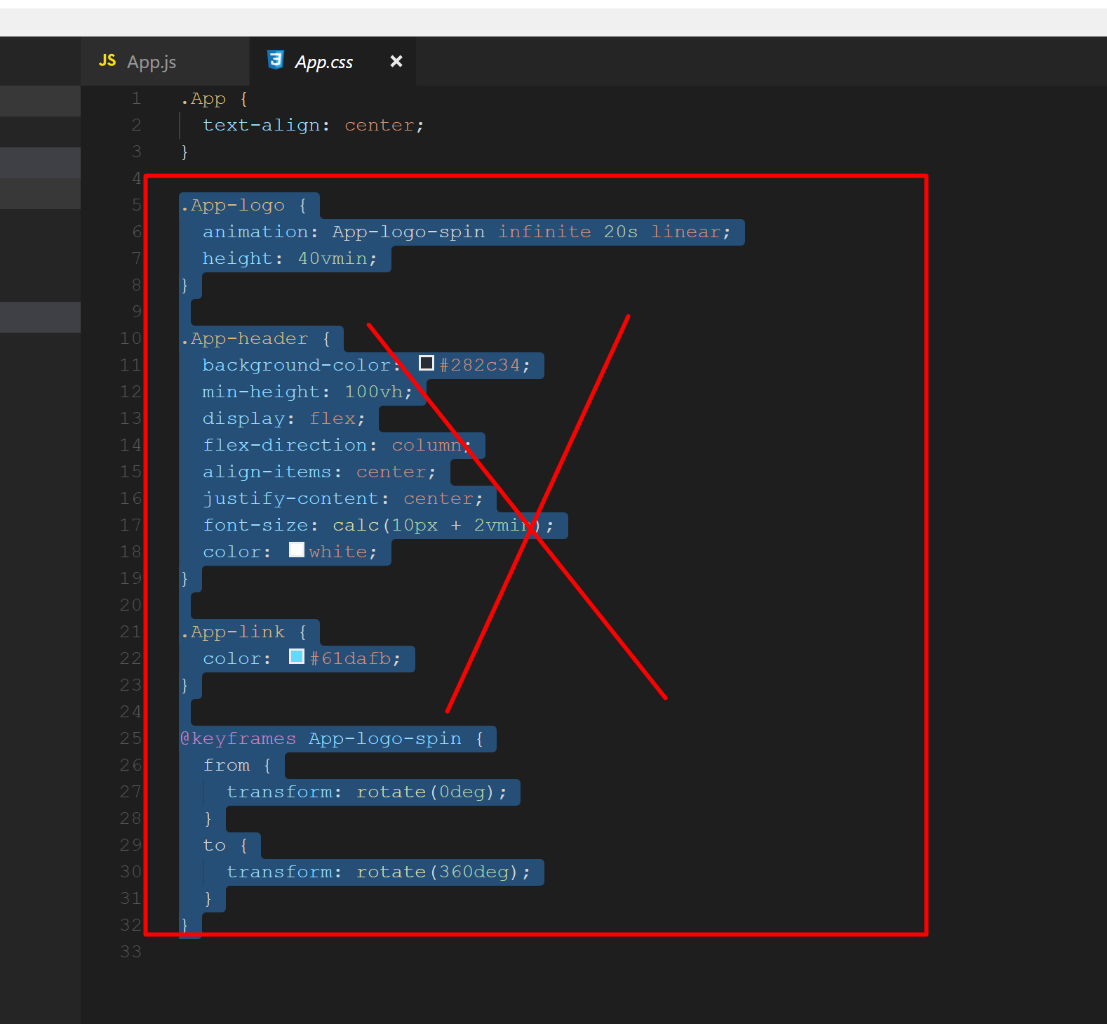
Go to App.css and remove the classes except .App

Slide 53
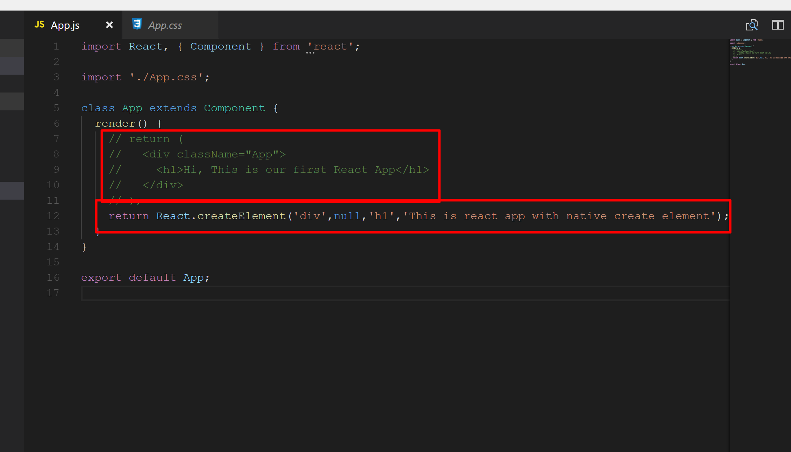
Open App.js file. Comment the shown code and use React.createElement() as shown below

Slide 54
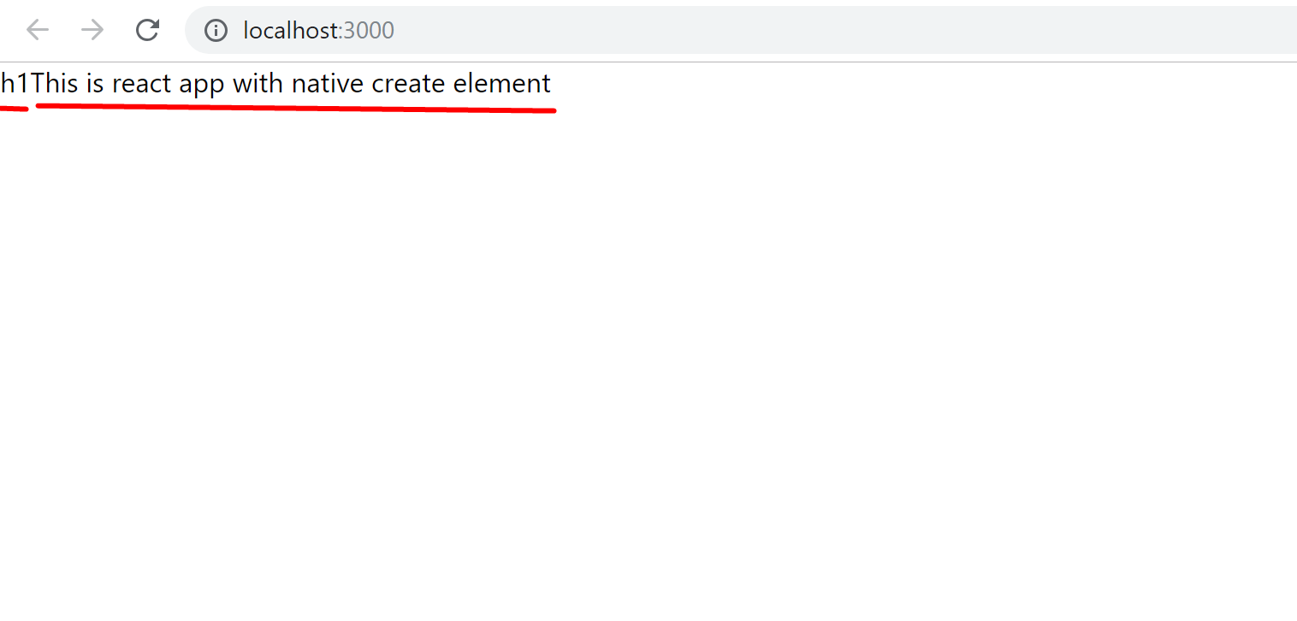
Check the output. You can see the code will add two html elements. It is not applying h1 effect.

Slide 55
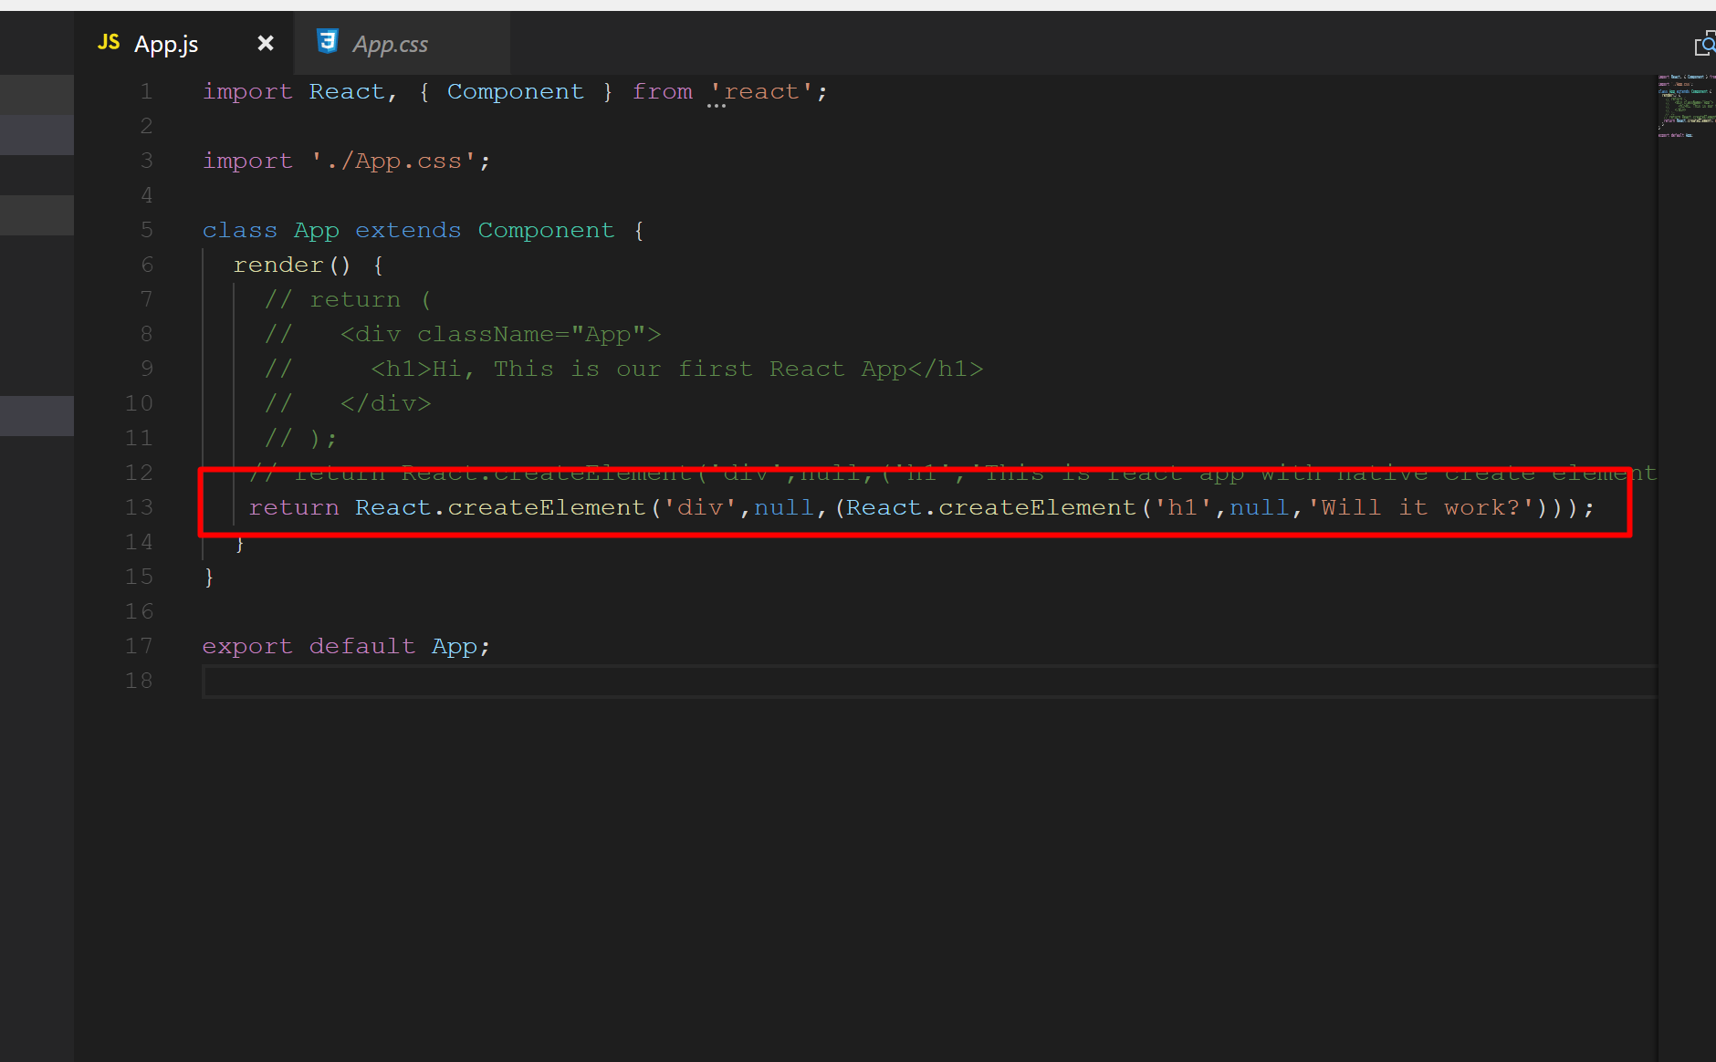
Now, modify the code block as shown below…

Slide 56
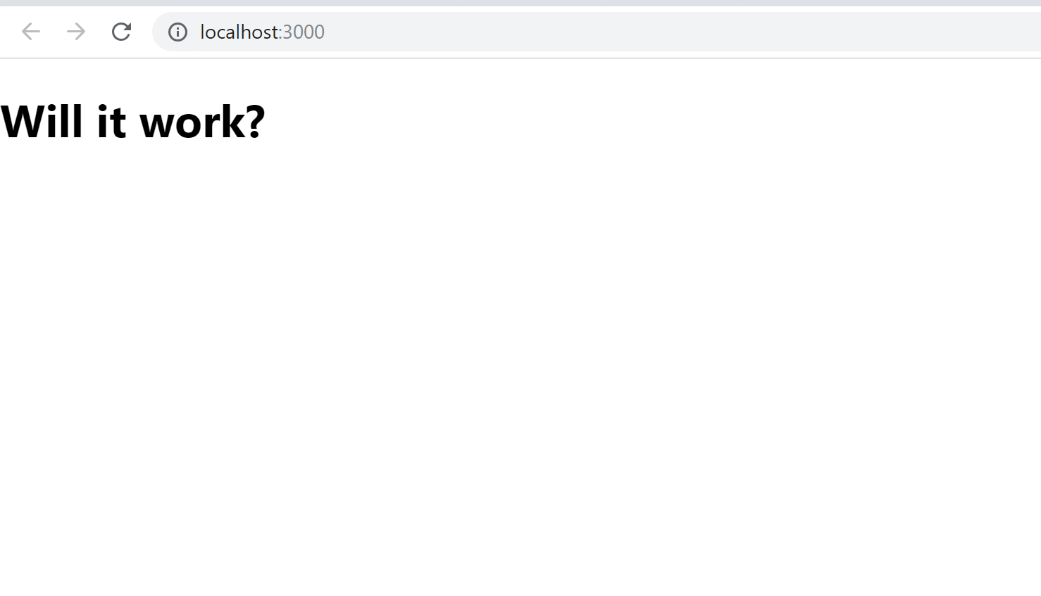
You can see now the h1 effect but still css class is not applied…

Slide 57
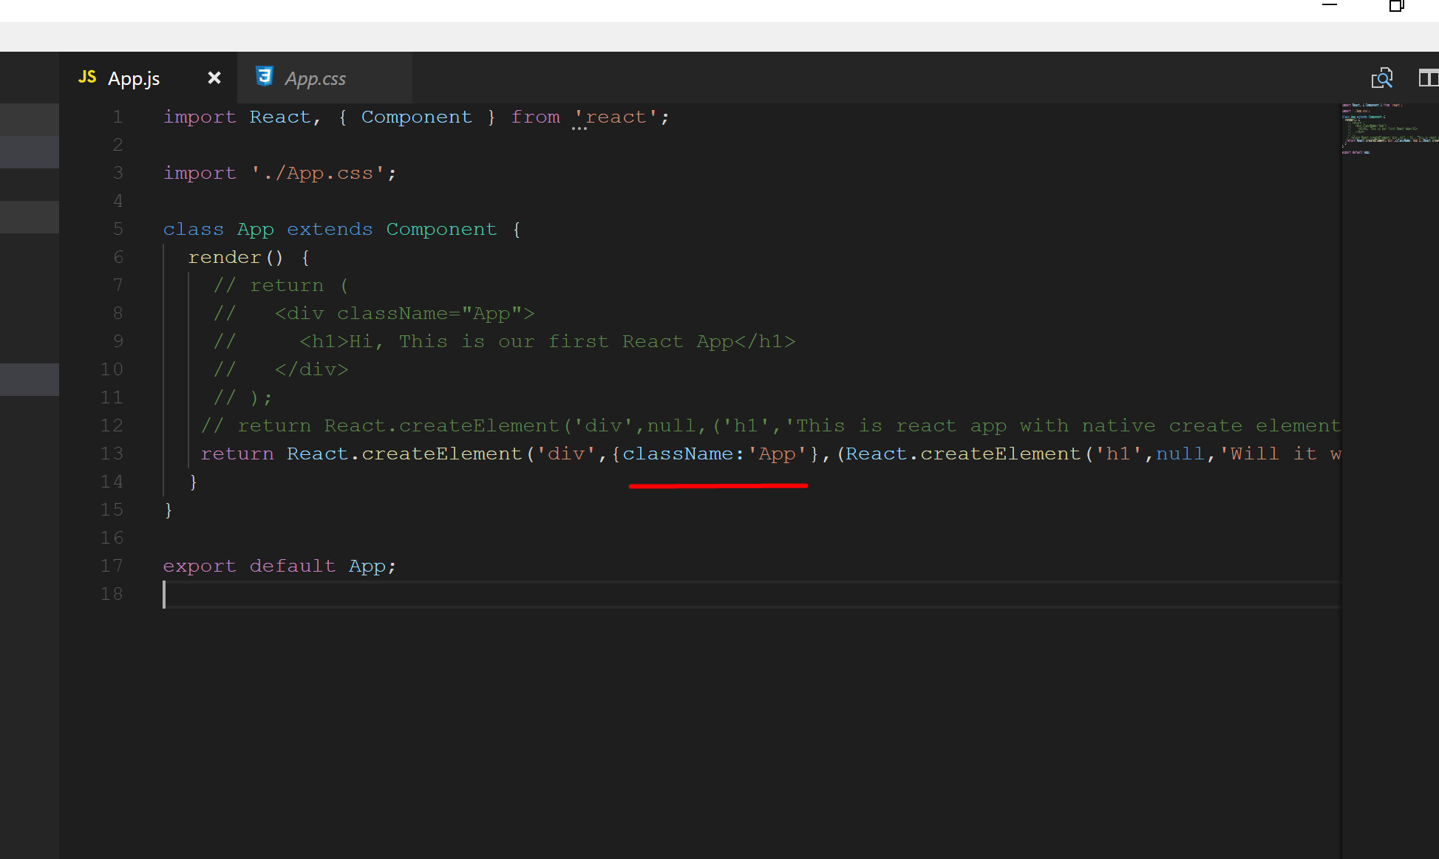
Modify the code block and add className:’App’

Slide 58
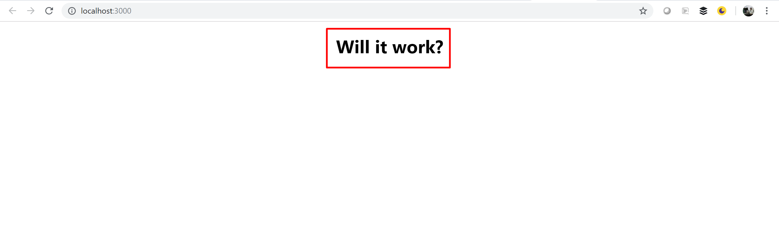
And you can see it is working now…

Slide 59
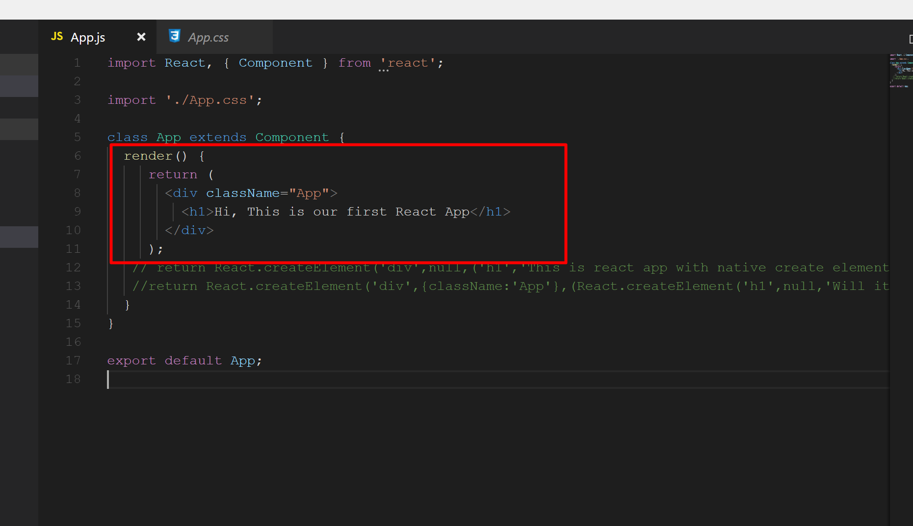
You can undo the changes…

Slide 60
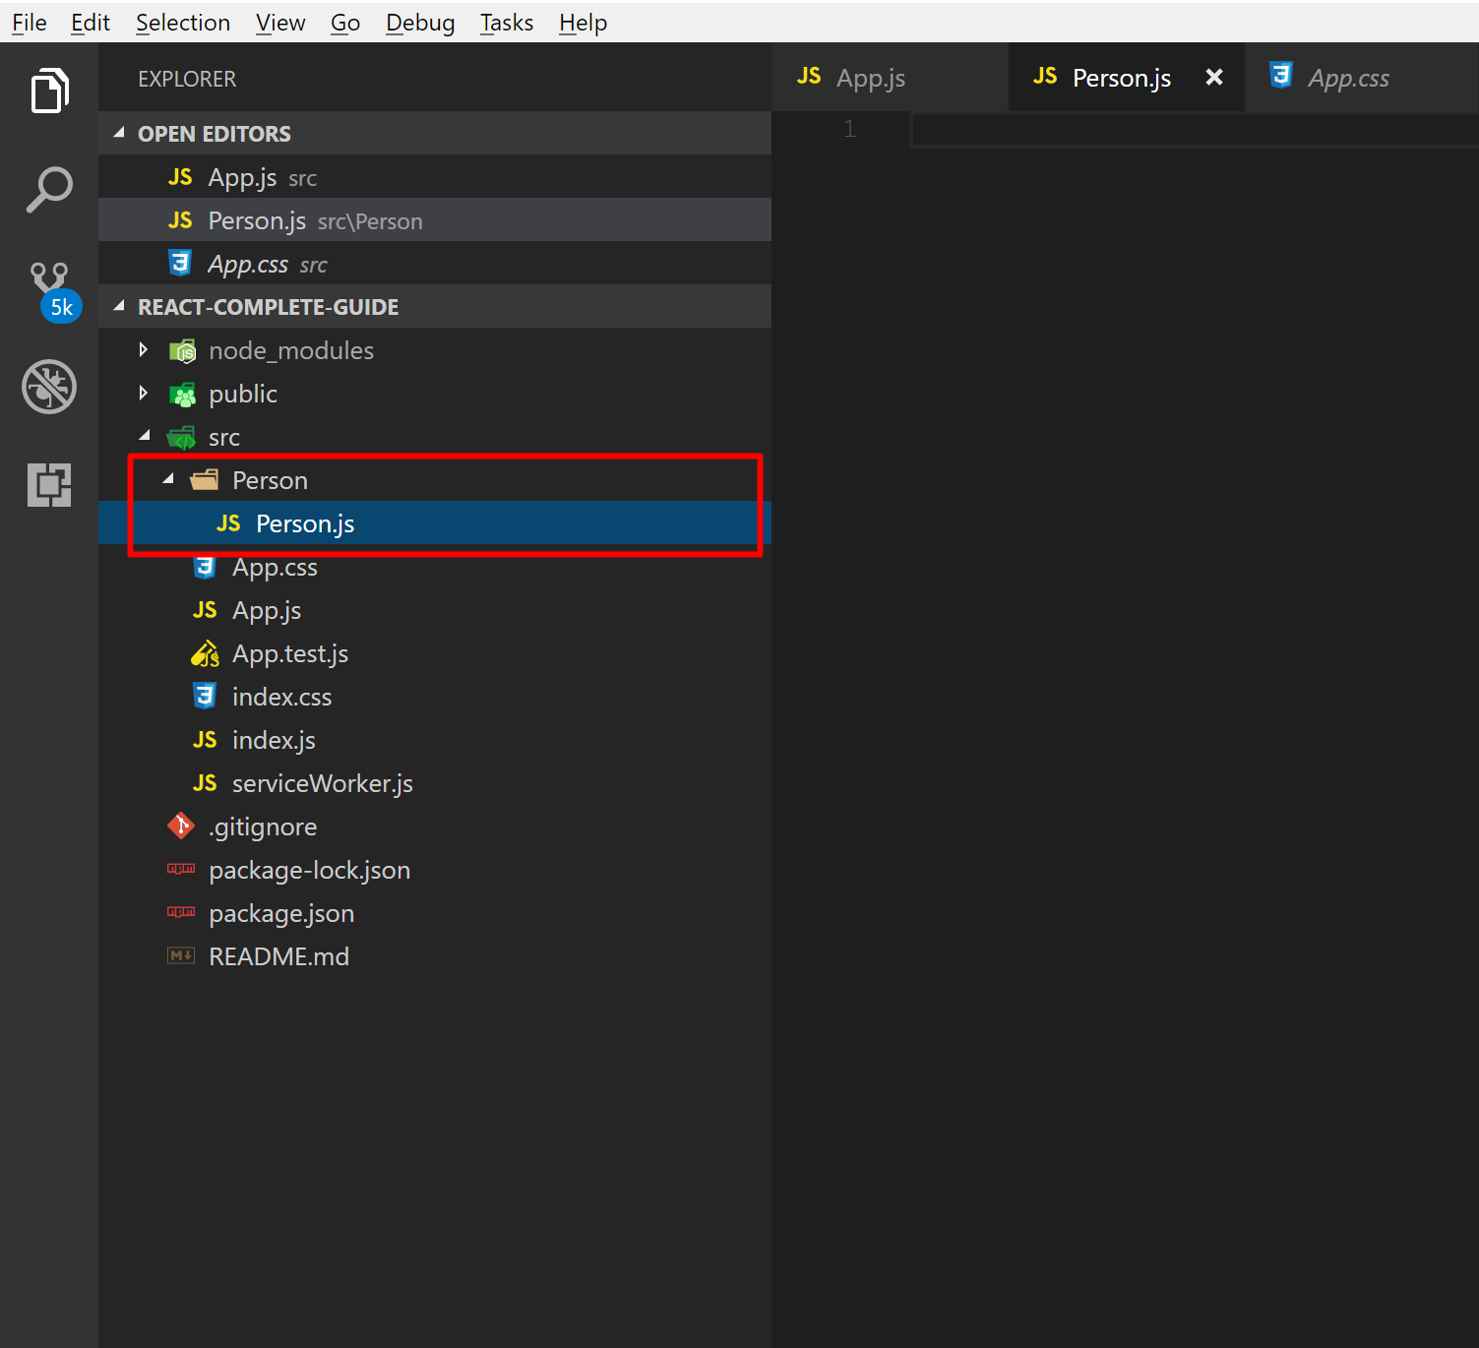
Right click on Src folder→ Add New Folder called Person. Within Person folder create new file Person.js

Slide 61
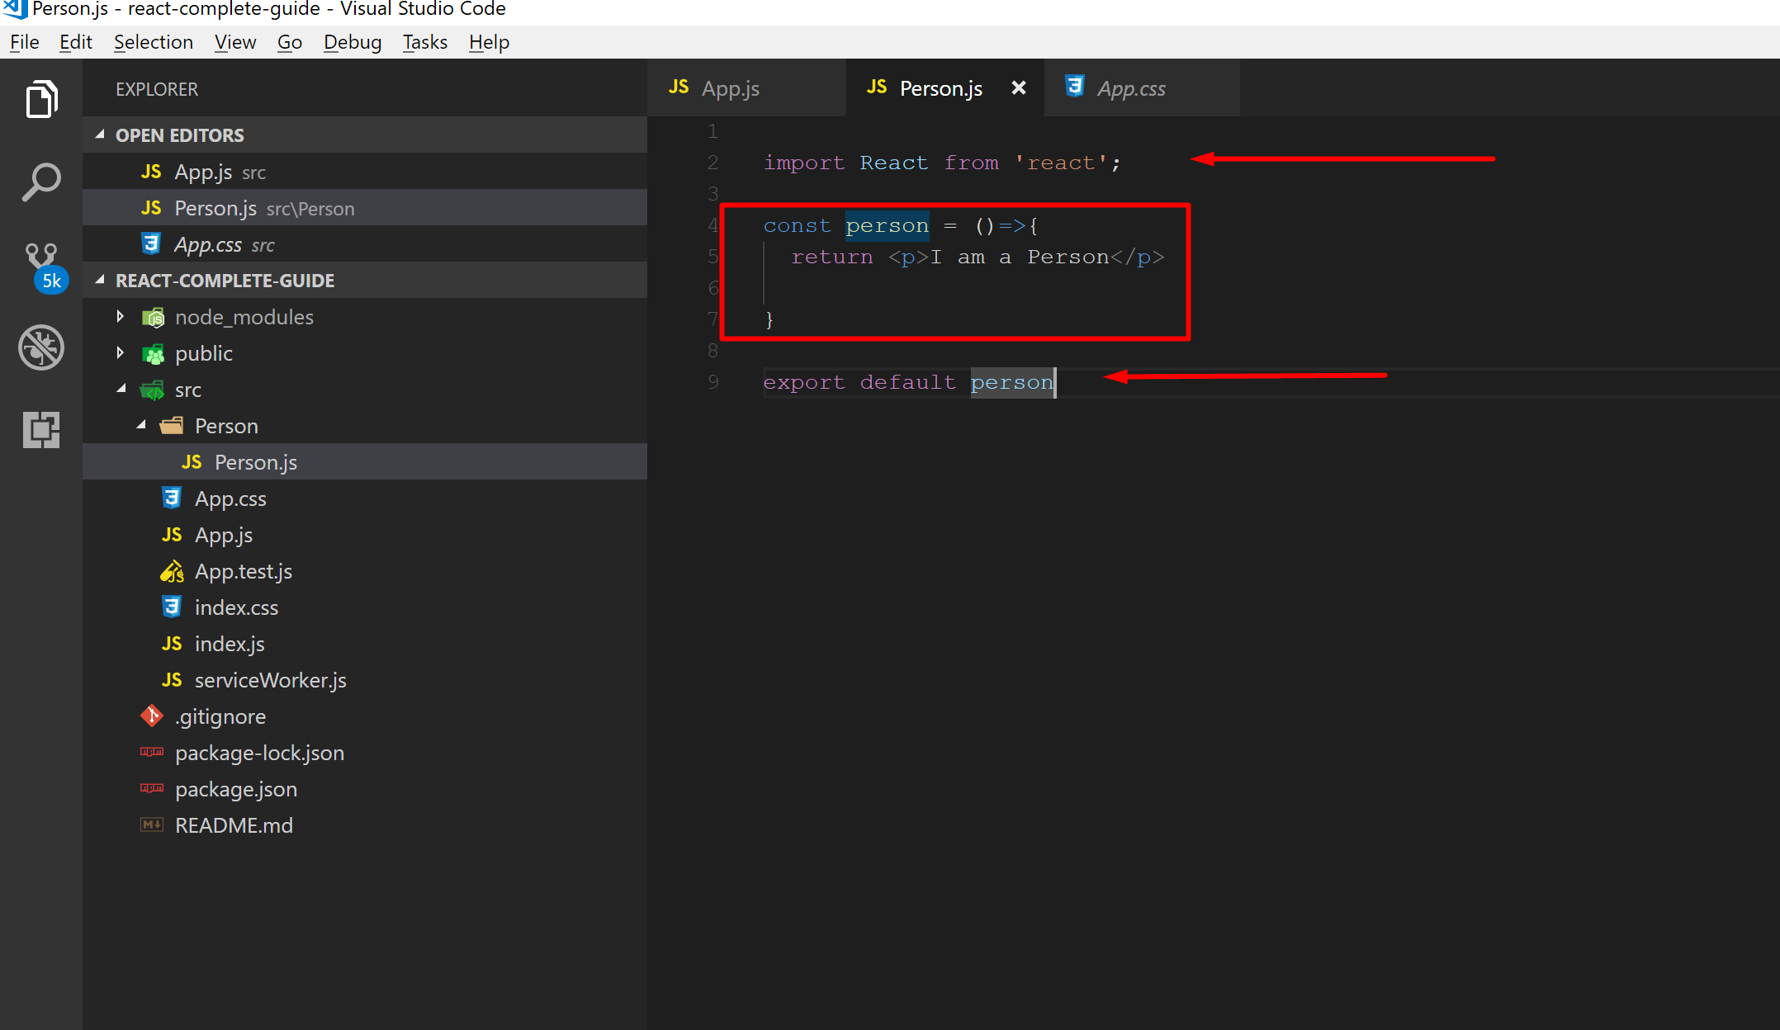
Prepare Person.js file as shown here….
Here, to create a component we have used Functional approach and not the Class approach so this is called a Functional component.

Slide 62
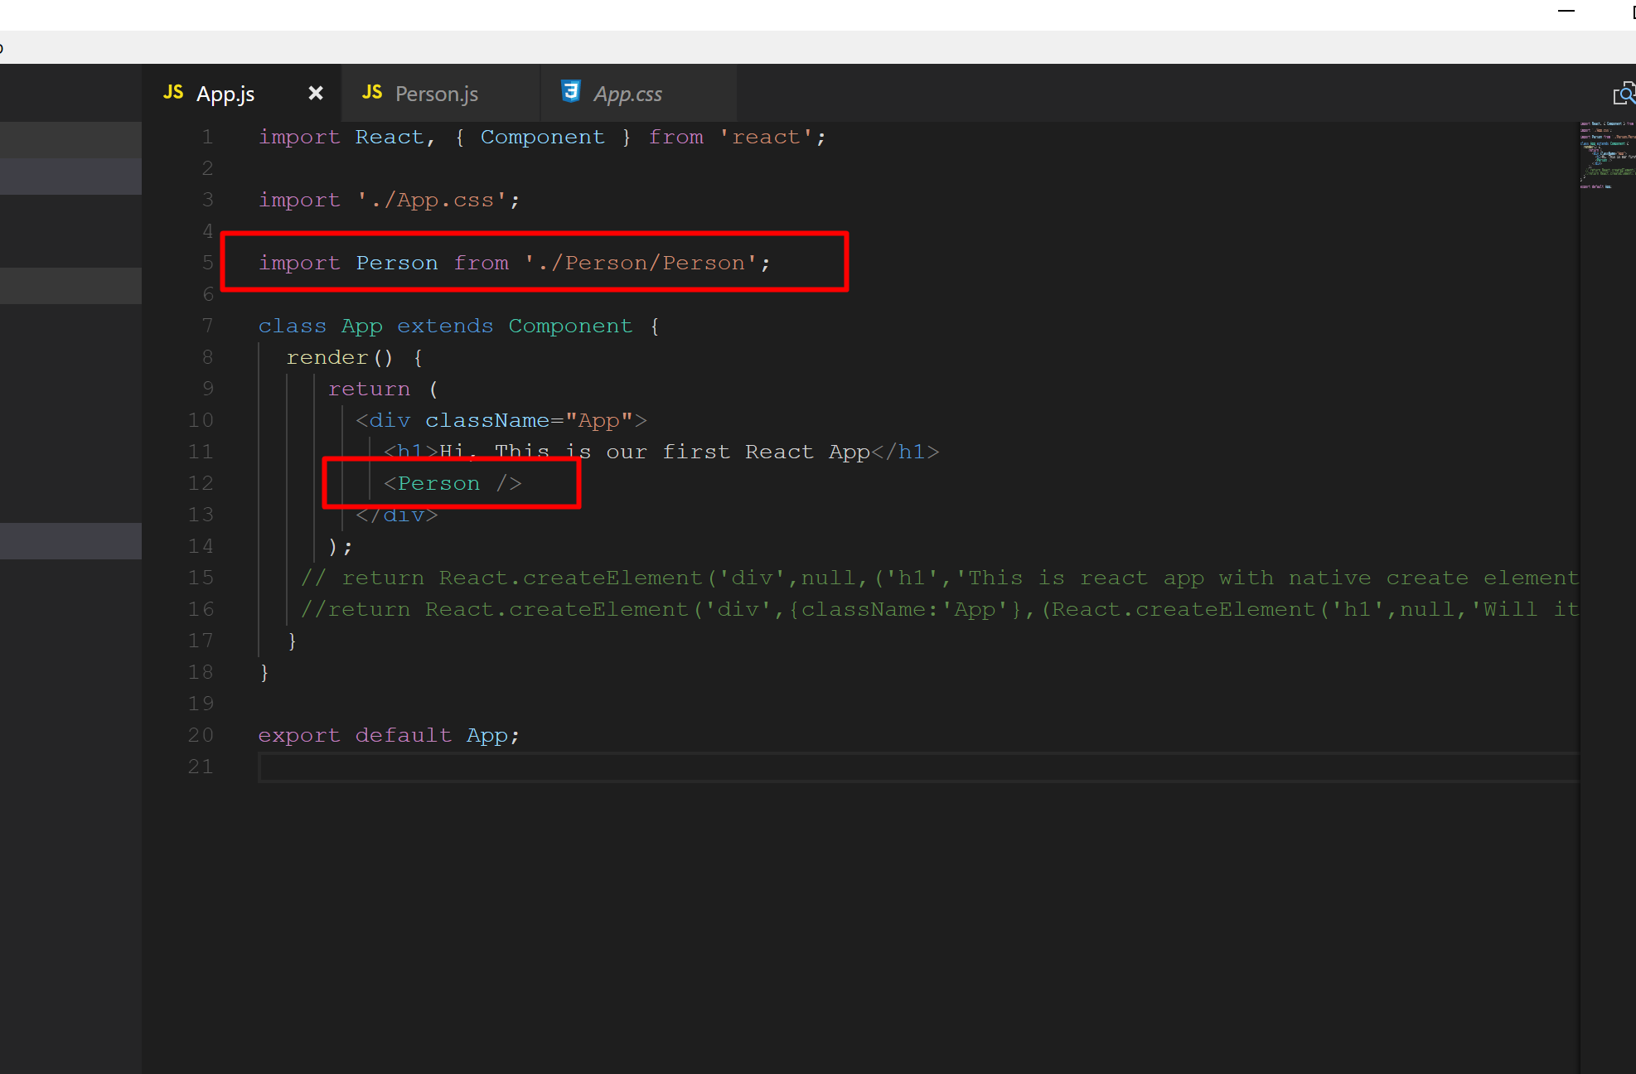
Open App.js and import Person component.

Slide 63


Slide 64

Open Person.js file and modify as shown below…

Slide 65

You can see still it is treated as a normal statement

Slide 66

Wrap it with a {} braces and check the output. To output something dynamic we have to wrap them with {} braces.

Slide 67

Some random number is generated.

Slide 68

We add the component one more time

Slide 69


Slide 70
Working with Props
Normal HTML elements are having attributes.
React components are having properties. Properties means attributes you add to your components. We can give any name to these attributes but in React we prefer a term called props.
Props give us access to all the attributes we pass to our own components.

Slide 71

Modify Person.js as shown here…

Slide 72

Now, open App.js file and modify your Person component import as shown below…

Slide 73

Run the application.
But what about the static text My Hobby is Reading?

Slide 74
I also want to output whatever we pass between the opening and closing tag of our custom component.
There is a special property we can access.React gives us access to this property. This is a special children property.
This is a reserved word.
Children refers to any elements and this includes plain text as we have it here between the opening and closing tag of our component and you could nest complex html code in between too.
This does not have to be just text, could be unordered list with multiple list items, could be other react components, anything can go between here.

Slide 75
Understanding the Children property
Children is the reserved word and reserved property.

Slide 76


Slide 77


Slide 78


Slide 79
State
Props are set and passed from outside like name and age into the person component, state is managed from inside a component and state is only available in components which are used by extending Component which is imported from React.
It is not available in the functional component.
We initialize it by assigning a value and this value is a JavaScript object again this is a reserved word and we should use it if we want to manage some component internal data.

Slide 80

Open App.js file and create a state. Here in this example state is a JavaScript array.

Slide 81

Modify the code block as shown below…

Slide 82

We create a function and triggered it on the button click.

Slide 83

Run the application and click the button.

Slide 84

Modify the function logic as shown here. We are trying to update the name value of first element of the state property.

Slide 85

If you run the application, you will get the error as shown

Slide 86
this.setState()
To update the state, React uses a special method called setState().
We do not define this method but remember that we extend component and this is made available by the react library and the component object happens to have a setState() method.
This is the method which allows us to update this special state property here and it will then ensure that react gets to know about this update and updates that dom.
setState() takes an object as an argument and it will merge whatever we define here with our existing state.
So if I here set persons to an updated array, it will merge this with existing data.
If I have some other state here that would not be touched.

Slide 87

Modify the function as shown below… Here we have used setState() method.

Slide 88

Runt the application and click the button.

Slide 89
Here we override persons since we clearly define a new version of persons here but we will leave other state untouched because we are not saying anything about it here.
The concept is you don’t have to update everything about your state whenever you want a change only a tiny piece about it.
States and props are only two things which lead React to update DOM.

Slide 90
Functional (Stateless) vs Class (stateful) components
Functional components can not use state within it. Because it is just a function where we return some JSX code.
You can’t use state property as well as you can’t call this.setState() method.

Slide 91

Open Person.js file and use props.krunal onClick() event of paragraph.

Slide 92

Passing method reference between components. Open App.js and modify code block

Slide 93
You can pass methods also as props so that you can call a method which might change a state in another component which does not have direct access to the state.

Slide 94

In App.js file modify the argument in the method as well as in the this.setState() method.

Slide 95

In App.js method, modify your code block and here we have used bind() method.

Slide 96
bind() method controls what this inside the function will refer to and by binding it to this here outside of the function we are binding it to the class.
Second parameter is the list of arguments actually which will be passed into our function. newName in our case.

Slide 97

The another way of doing the same…

Slide 98

Run the application and check the output.

Slide 99

Adding Two way binding. In App.js file we create a new function called nameChangeHandler() and by using setState() method update the value of name of the first element and age of third element.

Slide 100

In the App.js file, add a property called krunalchanged and pass your method. Krunalchanged is my property name, you can give appropriate name like changed…

Slide 101

Now open Person.js file and add a textbox.

Slide 102

Now on the textbox I called onChange event handler…

Slide 103

Run app and check output.

Slide 104

To display the initial value, we use value={props.name}

Slide 105


Slide 106


